Slide 1




Welcome to Town Farm Primary School & Nursery
Rated OUSTANDING by Ofsted
in all 5 areas 11th March 2025
__________________________________________________________
Every Child, Every Day, Every Moment
Our values: Ambition, Courage, Determination, Enquiry, Equality, Integrity, Resilience, Respect

Slide 2
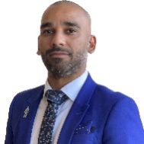
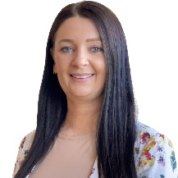
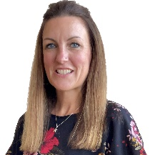
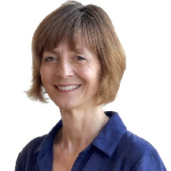
Meet the Senior Leadership Team
Mr Bhatti Headteacher
Miss Elliott Deputy Head Teacher | Mrs Shrimpton Deputy Head Teacher | Mrs Winch Assistant Head Teacher
__________________________________________________________
Every Child, Every Day, Every Moment
Our values: Ambition, Courage, Determination, Enquiry, Equality, Integrity, Resilience, Respect

Slide 3

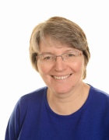

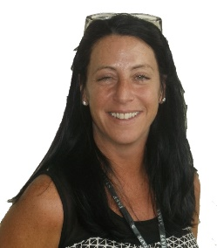
Meet the SENCO and Office Team
Mrs Banthorpe | Mrs Hadley | Mrs Chilton
__________________________________________________________
Every Child, Every Day, Every Moment
Our values: Ambition, Courage, Determination, Enquiry, Equality, Integrity, Resilience, Respect

Slide 4
Meet the Attendance Team
Miss Elliott Senior Attendance Champion | Mrs Chilton Attendance Officer
__________________________________________________________
Every Child, Every Day, Every Moment
Our values: Ambition, Courage, Determination, Enquiry, Equality, Integrity, Resilience, Respect

Slide 5




Welcome to Year 2
2025-2026
_________________________________________________________________________
Every Child, Every Day, Every Moment
Our values: Ambition, Courage, Determination, Enquiry, Equality, Integrity, Resilience, Respect

Slide 6
The Team
Blyton Class: Miss Keep and Miss Batterson
Zephaniah Class: Mrs McKenzie and Miss Weller
_________________________________________________________________________
Every Child, Every Day, Every Moment
Our values: Ambition, Courage, Determination, Enquiry, Equality, Integrity, Resilience, Respect

Slide 7
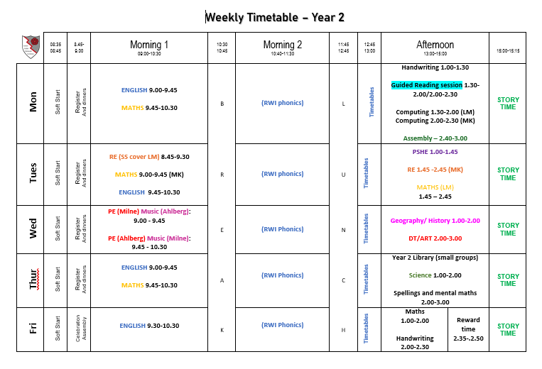
Our Year 2 Timetable
English and Maths are taught every day, along with phonics.
Our foundation subjects will be covered in the afternoon sessions.
PE – will be on a Wednesday
Library will be on a Thursday
Spelling test will be on a Thursday
_________________________________________________________________________
Every Child, Every Day, Every Moment
Our values: Ambition, Courage, Determination, Enquiry, Equality, Integrity, Resilience, Respect

Slide 8
Important days in the week
LIBRARY: Thursday – Children bring home a sharing book
PE: Wednesday
Home learning:
Will be given out on a Friday and needs to be returned by the following Wednesday.
Spelling: These will be sent out with homework on a Friday
Spelling tests will be every Thursday.
_________________________________________________________________________
Every Child, Every Day, Every Moment
Our values: Ambition, Courage, Determination, Enquiry, Equality, Integrity, Resilience, Respect

Slide 9

Expectations
Attendance: During term times, your child should attend school regularly. Regular attendance now means 100% of the time the school is open, the minimum target is 96% attendance.
If your child is absent from school please notify the school on the first day of absence by telephone or email.
_________________________________________________________________________
Every Child, Every Day, Every Moment
Our values: Ambition, Courage, Determination, Enquiry, Equality, Integrity, Resilience, Respect

Slide 10
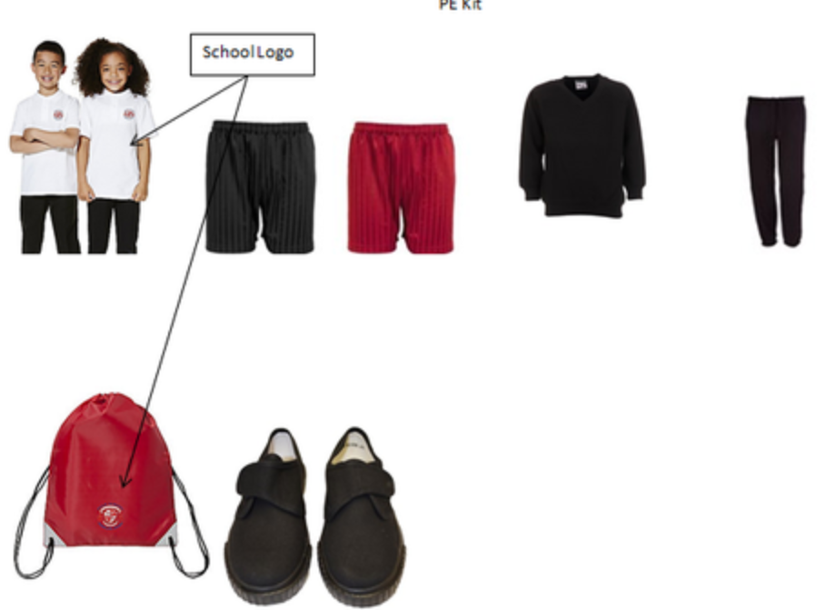
Expectations
Uniform: As per school policy: https://www.town-farm-surrey.uk/school-uniform/
PE kit: plain black tracksuit for winter and Town Farm white polo shirt or the new black Town Farm top.
We are a no earing/jewellery school.
_________________________________________________________________________
Every Child, Every Day, Every Moment
Our values: Ambition, Courage, Determination, Enquiry, Equality, Integrity, Resilience, Respect

Slide 11



Our Curriculum
English – Power of Reading
Maths – Mathematics Mastery
Foundations subjects – Planit
RE – Surrey
PSHE – Jigsaw
_________________________________________________________________________
Every Child, Every Day, Every Moment
Our values: Ambition, Courage, Determination, Enquiry, Equality, Integrity, Resilience, Respect

Slide 12

Home Learning
Daily Reading
To be completed every weekday Monday to Friday.
This is checked daily by the teaching assistant by looking in your child’s Reading Record. Please ensure it is signed so they can be rewarded for their reading.
These will be changed on a Friday.
When is homework given and due in?
On Friday homework is given out and will be due in the following Wednesday. Each week will be either English, maths or something linked to our foundation subjects.
_________________________________________________________________________
Every Child, Every Day, Every Moment
Our values: Ambition, Courage, Determination, Enquiry, Equality, Integrity, Resilience, Respect

Slide 13



If a child is unhappy we encourage them to speak out about it by:
Talking to a friend
Raising an issue in circle time
Talking to a member of staff
Talking to a learning mentor
Talking to class teacher
Putting a note in the worry eater (this will be seen by a learning mentor)
Speaking to a middle or senior leader
Pupil concerns
If a child is unhappy we encourage them to speak out about it by:
Talking to a friend
Raising an issue in circle time
Talking to a member of staff
Daily check in
Zones of regulation
Did you know our pupils have a daily check-in for their well-being?
_________________________________________________________________________
Every Child, Every Day, Every Moment
Our values: Ambition, Courage, Determination, Enquiry, Equality, Integrity, Resilience, Respect

Slide 14

Safeguarding
Your child’s safety is our priority and we have a shared responsibility to safeguard everyone in our school.
https://www.town-farm-surrey.uk/safeguarding/
SPA: 0300 200 1006
Emergency Duty team: 01483 517898
Surrey Police: 101 (or 999 in an emergency)
www.surreycc.gov.uk/safeguarding
_________________________________________________________________________
Every Child, Every Day, Every Moment
Our values: Ambition, Courage, Determination, Enquiry, Equality, Integrity, Resilience, Respect

Slide 15

Additional information
School Website
http://www.town-farm.surrey.sch.uk/
info@town-farm.surrey.sch.uk
If you have any questions please speak to a member of the Year 2 team who will be happy to help you.
_________________________________________________________________________
Every Child, Every Day, Every Moment
Our values: Ambition, Courage, Determination, Enquiry, Equality, Integrity, Resilience, Respect

