Slide 1




Welcome to Year 6
2025-2026
_________________________________________________________________________
Every Child, Every Day, Every Moment
Our values: Ambition, Courage, Determination, Enquiry, Equality, Integrity, Resilience, Respect

Slide 2
Year 6 Team
Hillary Class: Miss Hopton and Mrs Dredge
Darwin Class: Miss Taylor and Mrs Petre
_________________________________________________________________________
Every Child, Every Day, Every Moment
Our values: Ambition, Courage, Determination, Enquiry, Equality, Integrity, Resilience, Respect

Slide 3


Slide 4


Slide 5


Slide 6


Slide 7
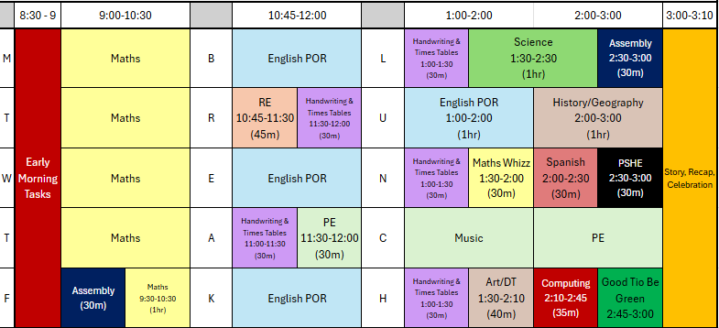
Year 6 Timetable
_________________________________________________________________________
Every Child, Every Day, Every Moment
Our values: Ambition, Courage, Determination, Enquiry, Equality, Integrity, Resilience, Respect

Slide 8
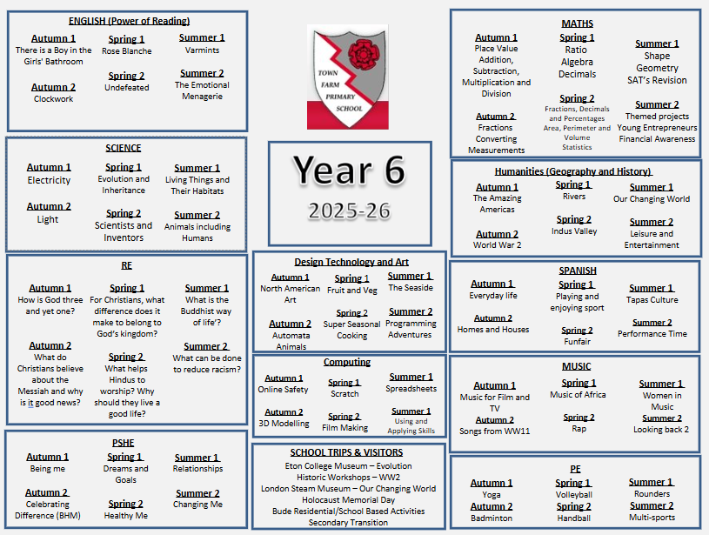

Slide 9
Year 6 - Behaviour
It is essential that Pupils at Town Farm School understand what is meant by good behaviour and that the rules we expect them to follow are clear and understandable. As such we believe all members of the school community should aspire to reach the Town Farm Standard, these include:
Following instructions first time
Treating everybody how we would like to be treated ourselves
Keeping hands, feet and unkind words to ourselves and reporting grievances to a member of staff, who will take appropriate action
Respecting everybody, including ourselves
Caring for our school and everything in it including other peoples’ property and school equipment
Being good learners and allowing everyone to learn together
Listening to whoever is talking and being well-mannered
Wearing the correct uniform at all times
Walking through the school silently between classrooms and hall spaces
_________________________________________________________________________
Every Child, Every Day, Every Moment
Our values: Ambition, Courage, Determination, Enquiry, Equality, Integrity, Resilience, Respect

Slide 10
Year 6 – Behaviour Rewards
So that pupils can feel good about themselves and the school, we give a range of rewards for good behaviour, example of which are listed below:
Verbal rewards
Positive messages/notes home
Class certificates
Silver stickers towards a gold star badge
Green tokens towards class reward time
Weekly Good to be Green time
_________________________________________________________________________
Every Child, Every Day, Every Moment
Our values: Ambition, Courage, Determination, Enquiry, Equality, Integrity, Resilience, Respect

Slide 11
Year 6 – Behaviour Rewards
Friday's celebration assembly is designed to provide opportunities for all staff to acknowledge the following:
• Excellent achievements in a child’s learning
• Outstanding or sustained improved behaviours or attendance
• Contributions to the life of the class or the school community
• Success in extracurricular activities and activities which take place outside school
We believe in sharing pupil’s success with parents and weekly newsletters celebrate these pupil’s achievements. Over the course of an academic year each pupil will strive to receive a reward in a celebration assembly.
_________________________________________________________________________
Every Child, Every Day, Every Moment
Our values: Ambition, Courage, Determination, Enquiry, Equality, Integrity, Resilience, Respect

Slide 12
Year 6 – Behaviour - Sanctions
Our values: Ambition, Courage, Determination, Enquiry, Equality, Integrity, Resilience, Respect
In cases when the Town Farm Standards are broken and restorative justice has not resolved the incident, a series of sanctions will be applied. It is the responsibility of the member of staff who is involved, witnesses or experiences the break in standards to issue the
1. Look/check behaviour
2. First warning
3. Second warning - card warning (recorded by moving a pupil to yellow on the Good to be Green chart followed by 5 minute restorative justice session at the next natural break with the member of staff issuing the sanction, explaining the behaviour seen and why it doesn’t meet the Town Farm Standard).
4. Red card (recorded by a red card on the Good to be Green chart and further recorded on Arbor. The person giving the red card will discuss the behaviour seen with the pupil, which has led to the red card and then inform the class teacher. This is followed by a playtime detention with the Learning Mentor Team. Parents will be informed either in person, by letter or by telephone by the class teacher). The class teacher is required to check the Arbor system daily to ensure any red cards are dealt with in accordance to policy prior to resolving the matter on Arbor.
5. Time out in a partner class until the end of the session with work can be given to help these pupils manage their behaviour choices.
6. In an emergency, a telephone call to a member of the leadership team, who may allocate a Learning Mentor to attend.
_________________________________________________________________________
Every Child, Every Day, Every Moment
Our values: Ambition, Courage, Determination, Enquiry, Equality, Integrity, Resilience, Respect

Slide 13
Year 6 - Privileges
Bude residential trip
Non-Bude activity week
Becoming a prefect – representing the school
Year 6 Gala
Year 6 BBQ
Sailing
Bikeability
End of year production
_________________________________________________________________________
Every Child, Every Day, Every Moment
Our values: Ambition, Courage, Determination, Enquiry, Equality, Integrity, Resilience, Respect

Slide 14
Year 6 – Expectations
School Uniform
Uniform: As per school policy: https://www.town-farm-surrey.uk/school-uniform/
Years R-6 Summer Uniform | White blouse or long sleeved shirt School red sweat cardigan or red V-neck sweatshirt with school logo School tie (elasticated for R-Y2) Grey skirt, pinafore dress or grey trousers Black or grey tights White, grey or black socks Reversible red school fleece jacket or similar red/black waterproof coat Flat black polishable shoes Red woolly hat with school logo if required Town Farm book bag or ruck sack Red and white check dress Short sleeved white blouse or shirt Grey skirt or pinafore dress Grey trousers – long or short School tie (elasticated for R-Y2) White, grey or black socks Flat black polishable shoes Grey, black, white or red cap with school logo Town Farm book bag or ruck sack
PE Kit for all children | School white polo shirt Black sports shorts or black skorts White, grey or black socks Black trainers (Velcro fastening until pupils can independently tie laces) Plain black jogging bottoms and plain black sweatshirt for the winter – no logos or stripes please. Swimwear – swimming costume or swim shorts, no bikinis please
_________________________________________________________________________
Every Child, Every Day, Every Moment
Our values: Ambition, Courage, Determination, Enquiry, Equality, Integrity, Resilience, Respect

Slide 15
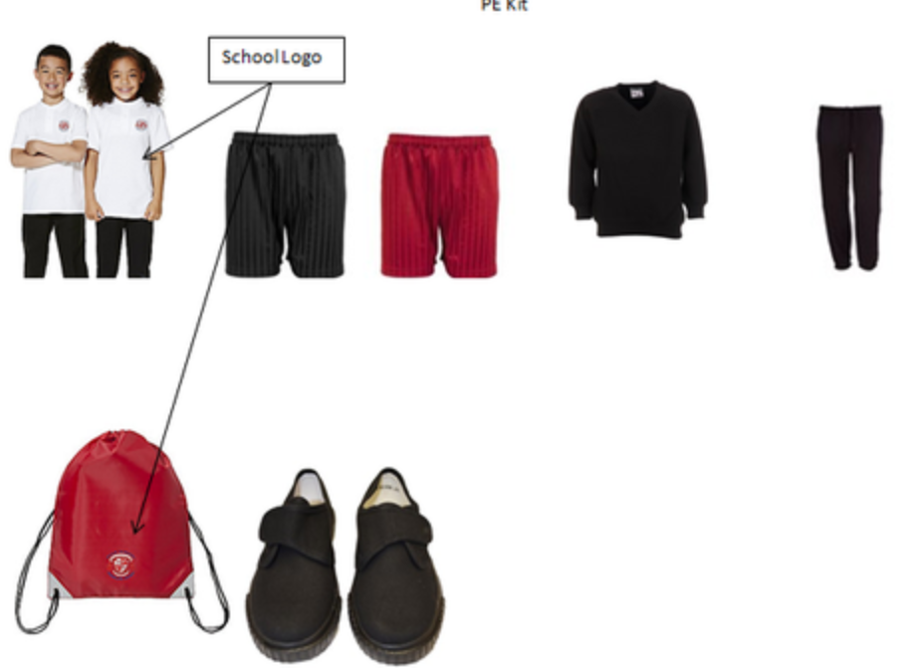
Expectations – PE Kit
PE kit must be worn into school on Thursdays
PE Kit for all children:
School white polo shirt
Red/black shorts
White, grey or black socks
Black trainers (Velcro fastening until pupils can independently tie laces)
Plain black jogging bottoms and plain black sweatshirt for the winter
no logos or stripes please.
_________________________________________________________________________
Every Child, Every Day, Every Moment
Our values: Ambition, Courage, Determination, Enquiry, Equality, Integrity, Resilience, Respect

Slide 16

Expectations
Attendance: During term times, your child should attend school regularly. Regular attendance now means 100% of the time the school is open, the minimum target is 96% attendance.
If your child is absent from school please notify the school on the first day of absence by telephone or email.
_________________________________________________________________________
Every Child, Every Day, Every Moment
Our values: Ambition, Courage, Determination, Enquiry, Equality, Integrity, Resilience, Respect

Slide 17




Our Curriculum
English – Power of Reading
Maths – White Rose
Foundation Subjects – Plan It
RE – Surrey
PSHE – Jigsaw PE –
Spanish – Primary Languages Network
_________________________________________________________________________
Every Child, Every Day, Every Moment
Our values: Ambition, Courage, Determination, Enquiry, Equality, Integrity, Resilience, Respect

Slide 18


Homework
Daily Reading
To be completed every weekday Monday to Friday.
This is checked daily by the teacher in their Reading Record.
Daily Spellings
These spellings are tested on Friday afternoon every week.
Weekly Homework
Monday – Maths – due in on Wednesday.
Wednesday – English/Grammar – due in on Friday.
Friday – Topic – due in on Monday.
We love Times Tables Rockstars too and reward pupils in who play at home.
_________________________________________________________________________
Every Child, Every Day, Every Moment
Our values: Ambition, Courage, Determination, Enquiry, Equality, Integrity, Resilience, Respect

Slide 19


Slide 20
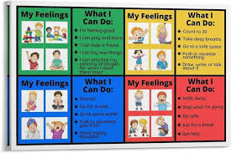
If a child is unhappy we encourage them to speak out about it by:
Talking to a friend
Raising an issue in circle time
Talking to a member of staff
Talking to a learning mentor
Talking to class teacher
Putting a note in the worry eater (this will be seen by a learning mentor)
Speaking to a middle or senior leader
Pupil concerns
If a child is unhappy, we encourage them to speak out about it by:
Talking to a friend
Raising an issue in circle time
Talking to a member of staff
Putting a note in the daily check-in box
Did you know our pupils have a daily check-in for their well-being?
_________________________________________________________________________
Every Child, Every Day, Every Moment
Our values: Ambition, Courage, Determination, Enquiry, Equality, Integrity, Resilience, Respect

Slide 21
Safeguarding
Your child’s safety is our priority and we have a shared responsibility to safeguard everyone in our school.
https://www.town-farm-surrey.uk/safeguarding/
SPA: 0300 200 1006
Emergency Duty team: 01483 517898
Surrey Police: 101 (or 999 in an emergency)
www.surreycc.gov.uk/safeguarding
_________________________________________________________________________
Every Child, Every Day, Every Moment
Our values: Ambition, Courage, Determination, Enquiry, Equality, Integrity, Resilience, Respect

Slide 22

Additional information
School Website - http://www.town-farm.surrey.sch.uk/
upperks2@town-farm.surrey.sch.uk
If you have any questions please speak to a member of the Year 6 team who will be happy to help you.
_________________________________________________________________________
Every Child, Every Day, Every Moment
Our values: Ambition, Courage, Determination, Enquiry, Equality, Integrity, Resilience, Respect

