Slide 1

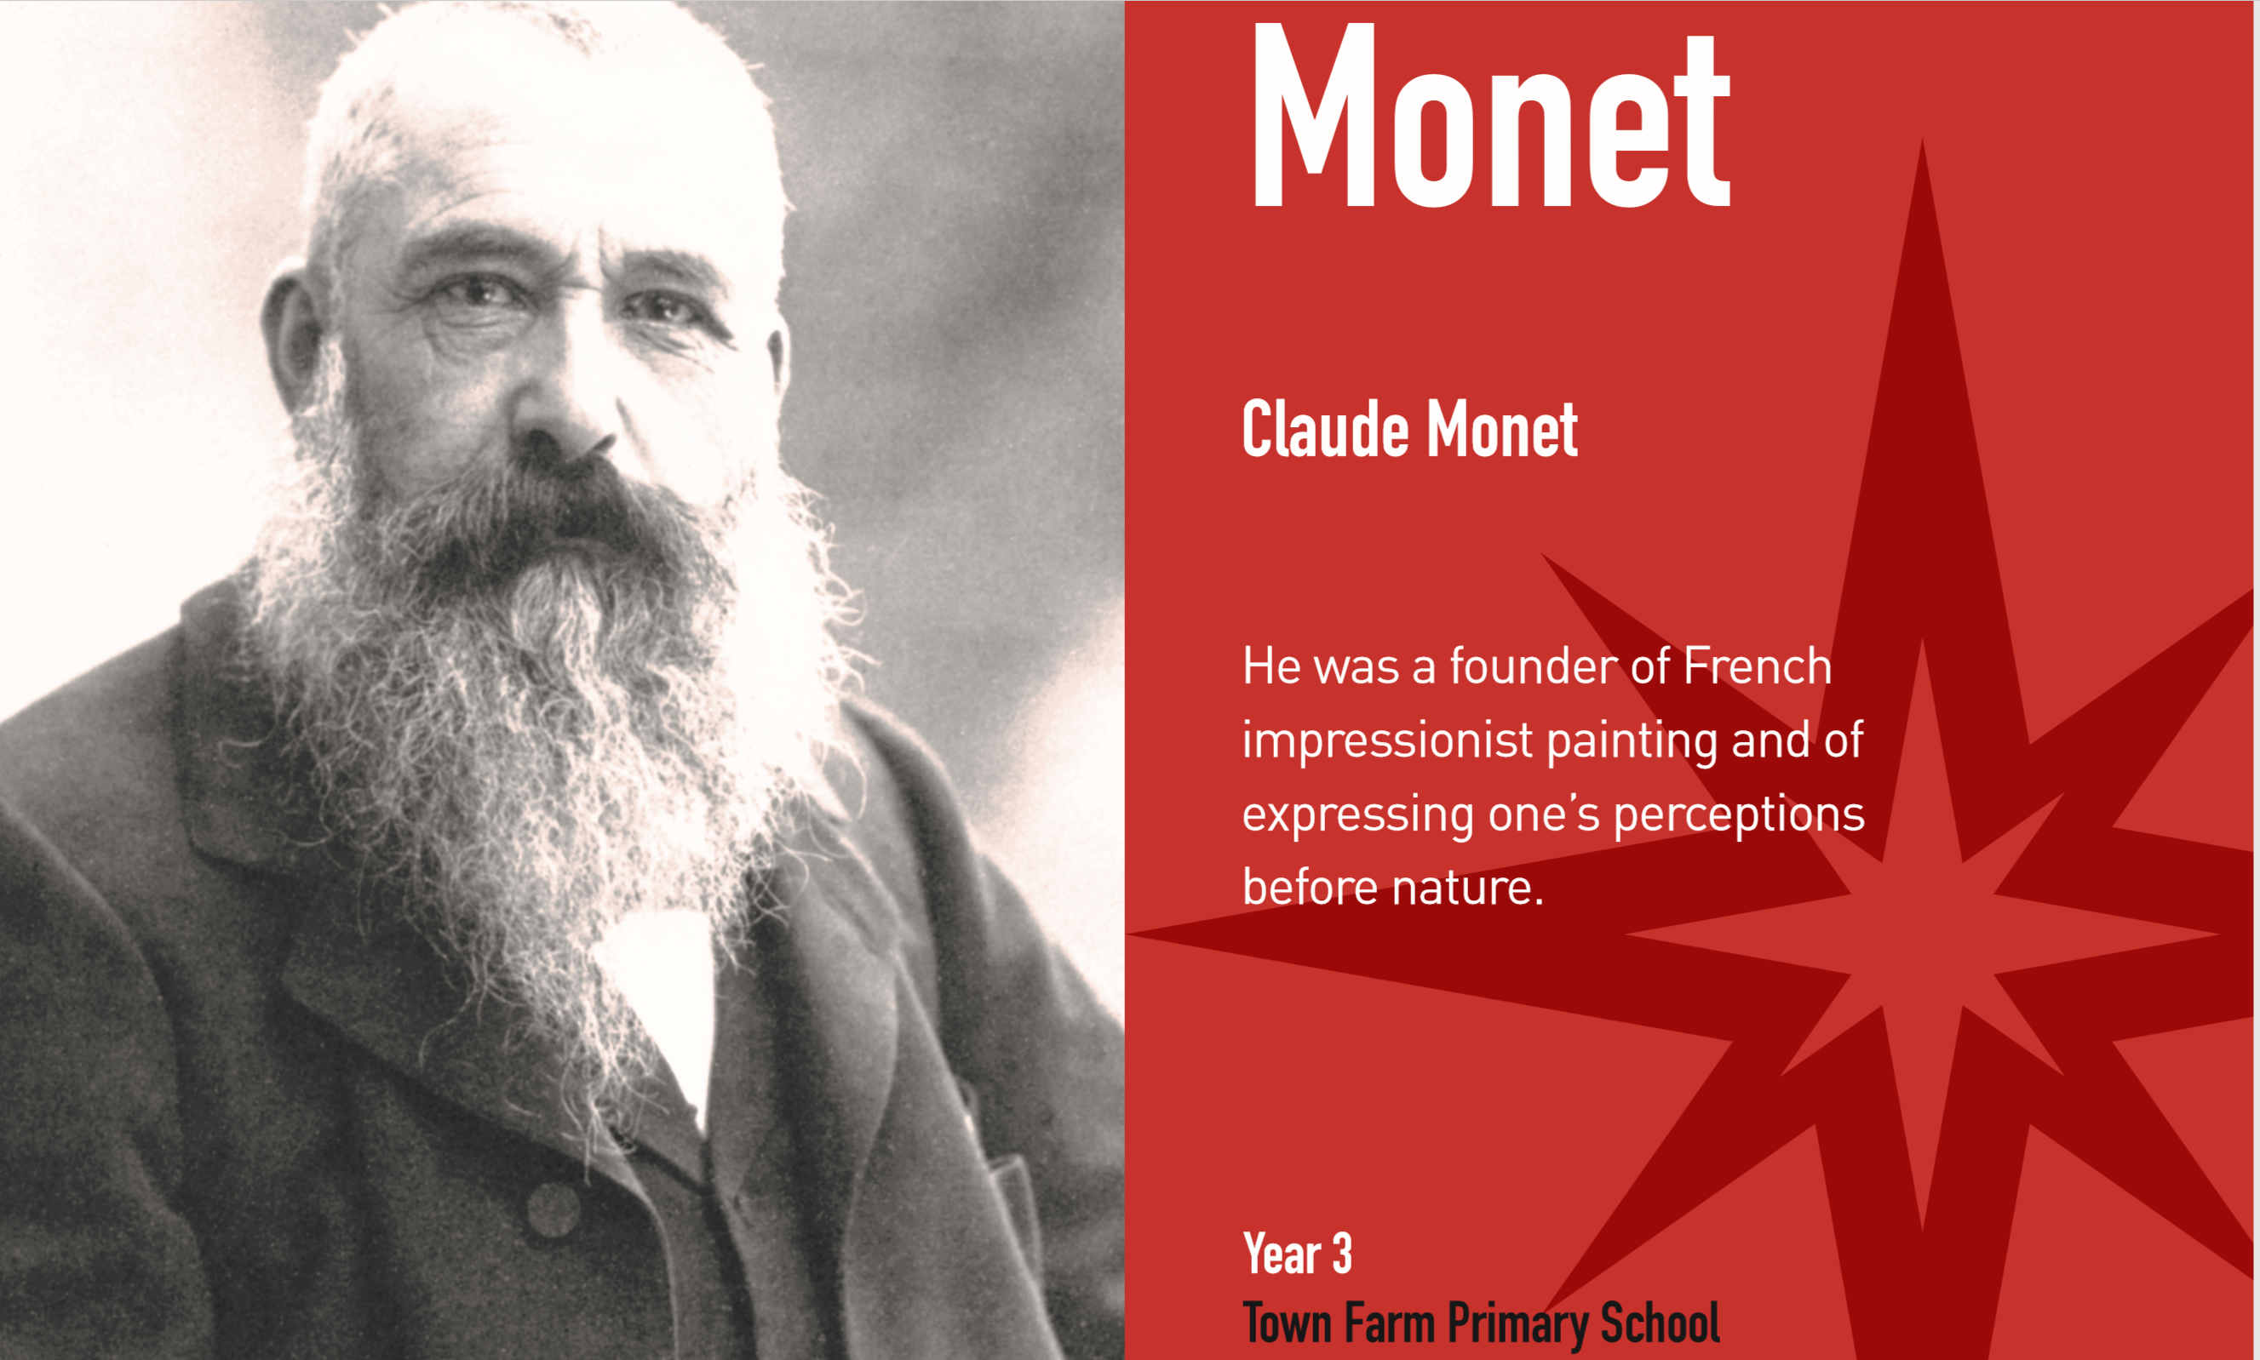


Welcome to Year 3
2025-2026
_________________________________________________________________________
Every Child, Every Day, Every Moment
Our values: Ambition, Courage, Determination, Enquiry, Equality, Integrity, Resilience, Respect

Slide 2
The Team
Monet Class: Mrs Elias and Mrs Latimer
Picasso Class: Mrs Spiking and Mrs Nagpal
_________________________________________________________________________
Every Child, Every Day, Every Moment
Our values: Ambition, Courage, Determination, Enquiry, Equality, Integrity, Resilience, Respect

Slide 3
 | 8:30 -9:00 | 9:00 - 9:30 | 9:30 – 10:00 | 10:00 - 10:30 | 10:30 - 10:45 | 10:45 - 11:20 | 11:20 - 12:00 | 12:00 - 13:00 | 13:00 - 13:30 | 13:30 - 14:00 | 14:00 - 14:30 |  | 14:30 - 15:00 | 15:00 - 15:15
Monday | Early Morning Work (DIRT) | Maths |  | Guided Reading | BREAK | English |  | LUNCH | Handwriting & Times Tables | Science / Library |  |  | Assembly | Home Time Story
Tuesday | Early Morning Work (DIRT) | Guided Reading | R.E. Monet pi K.E. TLR |  |  | English |  |  | Handwriting & Times Tables | I.C.T. Picasso |  | R.E. Picasso |  | Home Time Story
 |  |  |  |  |  |  |  |  |  | Maths - Monet |  | I.C.T. -Monet
 |  | Maths Picasso |  | Guided Reading
Wednesday | Early Morning Work (DIRT) | Maths Whizz |  | Guided Reading |  | Handwriting & Times Tables | C.T. P.E Monet |  | P.E. Monet |  | Music Monet |  |  | Home Time Story
 |  |  |  |  |  | C.T. P.E. Picasso | Handwriting & Times Tables
 |  |  |  |  |  |  |  |  | Music Picasso |  | P.E. Picasso
Thursday | Early Morning Work (DIRT) | Maths |  | Guided Reading
 |  |  |  |  |  | English |  |  | Spellings & Times Tables | Geography |  | Spanish |  | Home Time Story
Friday | Early Morning Work (DIRT) | Assembly | Maths |  |  | English |  |  | Handwriting & Times Tables | D.T. & P.S.H.E. |  |  | GTBG | Home Time Story

Slide 4

Year 3 Timetable
Wednesday PE – pupils to come into school wearing their correct PE kit for the whole day.
Weekly homework (Maths, English or Topic) and spellings will be handed out every Friday. Completed homework is to be returned to school on Wednesday.
Spelling test every Friday morning.
Library slots:
  Monday afternoon – Picasso and Monet
Tuesday afternoon is our ICT slot
Weekly Whizz maths online.
Year 3’s swimming will take place in the Summer Term.
_________________________________________________________________________
Every Child, Every Day, Every Moment
Our values: Ambition, Courage, Determination, Enquiry, Equality, Integrity, Resilience, Respect

Slide 5
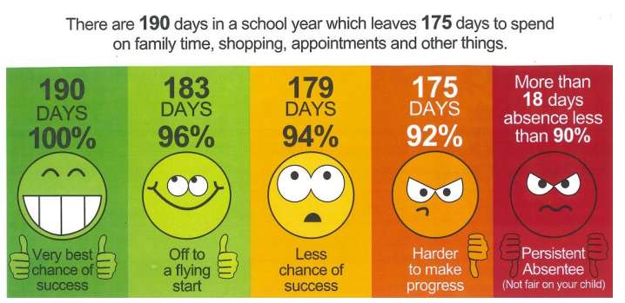
Expectations
Attendance: During term times, your child should attend school regularly. Regular attendance now means 100% of the time the school is open, the minimum target is 96% attendance.
If your child is absent from school, please notify the school on the first day of absence by telephone or email.
_________________________________________________________________________
Every Child, Every Day, Every Moment
Our values: Ambition, Courage, Determination, Enquiry, Equality, Integrity, Resilience, Respect

Slide 6
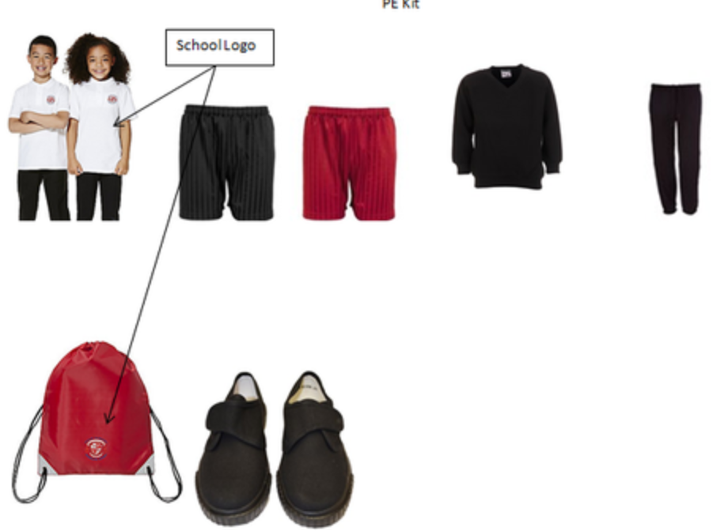
Expectations
Uniform: As per school policy: https://www.town-farm-surrey.uk/school-uniform/
PE kit: Worn on Wednesday: School white polo shirt
Black shorts,
White, grey or black socks
Plain black jogging bottoms and plain black sweatshirt for the winter – no logos or stripes please.
_________________________________________________________________________
Every Child, Every Day, Every Moment
Our values: Ambition, Courage, Determination, Enquiry, Equality, Integrity, Resilience, Respect

Slide 7




Our Curriculum
English – Power of Reading
Maths – White Rose
Foundations subjects – Plan it
RE – Surrey PSHE – Jigsaw
Music – Miss London
Spanish – Primary Languages Network
_________________________________________________________________________
Every Child, Every Day, Every Moment
Our values: Ambition, Courage, Determination, Enquiry, Equality, Integrity, Resilience, Respect

Slide 8
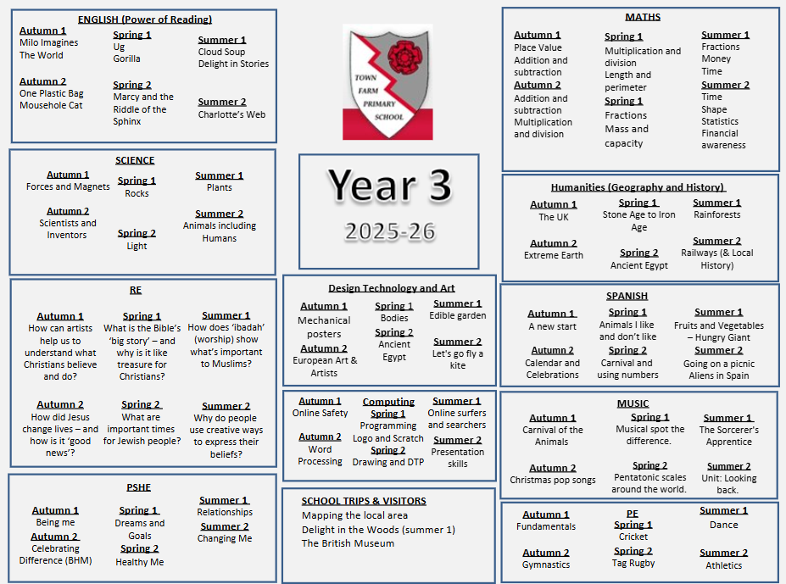
Year 3 Curriculum Map
_________________________________________________________________________
Every Child, Every Day, Every Moment
Our values: Ambition, Courage, Determination, Enquiry, Equality, Integrity, Resilience, Respect

Slide 9


Homework
Daily Reading
To be completed everyday - Monday to Friday.
This is checked daily by the teacher in their Reading Record.
When is homework given & due in?
On Friday homework is set for Maths, English and Topic.
Completed homework to be handed in on the following Wednesday. Spelling test on Friday morning.
Each half-term there will be a project homework that relates to the next topic.
We love Times Tables Rock Stars too and reward pupils in school who play at home.(Login details for each pupil are in their reading diaries).
_________________________________________________________________________
Every Child, Every Day, Every Moment
Our values: Ambition, Courage, Determination, Enquiry, Equality, Integrity, Resilience, Respect

Slide 10

Rewarding Reading
_________________________________________________________________________
Every Child, Every Day, Every Moment
Our values: Ambition, Courage, Determination, Enquiry, Equality, Integrity, Resilience, Respect

Slide 11

If a child is unhappy we encourage them to speak out about it by:
Talking to a friend
Raising an issue in circle time
Talking to a member of staff
Talking to a learning mentor
Talking to class teacher
Putting a note in the worry eater (this will be seen by a learning mentor)
Speaking to a middle or senior leader
Mental Health and wellbeing
If a child is unhappy we encourage them to speak out about it by:
Talking to a member of staff
Talking to a friend
Raising an issue in circle time
Using their daily check-in
Town Farm wellbeing page: Mental Health and Wellbeing | Town Farm Primary School (town-farm-surrey.uk)
Did you know our pupils have a daily check-in for their well-being?
_________________________________________________________________________
Every Child, Every Day, Every Moment
Our values: Ambition, Courage, Determination, Enquiry, Equality, Integrity, Resilience, Respect

Slide 12

Safeguarding
Your child’s safety is our priority, and we have a shared responsibility to safeguard everyone in our school.
https://www.town-farm-surrey.uk/safeguarding/
SPA: 0300 200 1006
Emergency Duty team: 01483 517898
Surrey Police: 101 (or 999 in an emergency)
www.surreycc.gov.uk/safeguarding
_________________________________________________________________________
Every Child, Every Day, Every Moment
Our values: Ambition, Courage, Determination, Enquiry, Equality, Integrity, Resilience, Respect

Slide 13

Additional information
School Website - http://www.town-farm.surrey.sch.uk/
If you have any questions please speak to a member of the Year 3 team who will be happy to help you.
_________________________________________________________________________
Every Child, Every Day, Every Moment
Our values: Ambition, Courage, Determination, Enquiry, Equality, Integrity, Resilience, Respect

