Slide 1
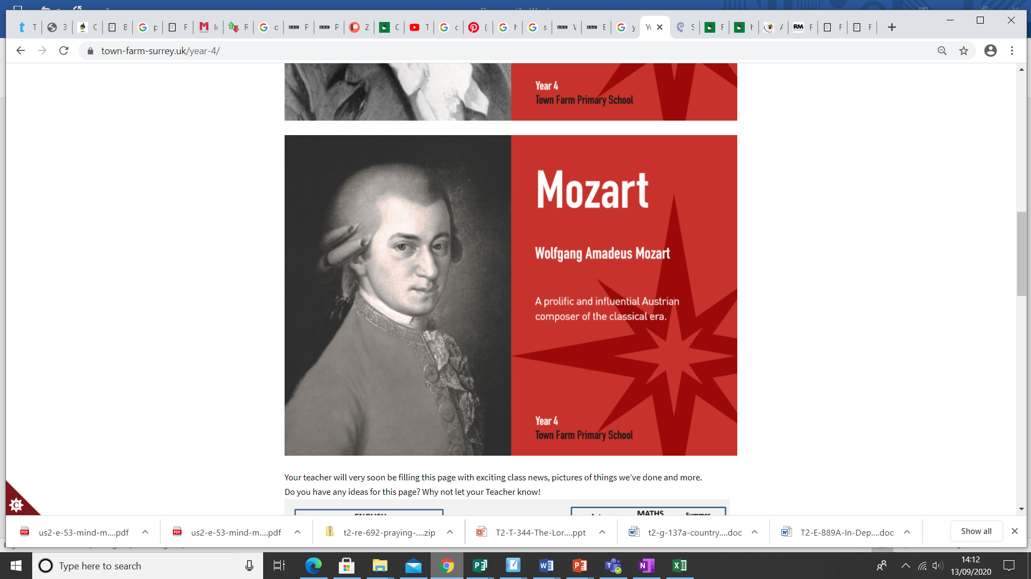
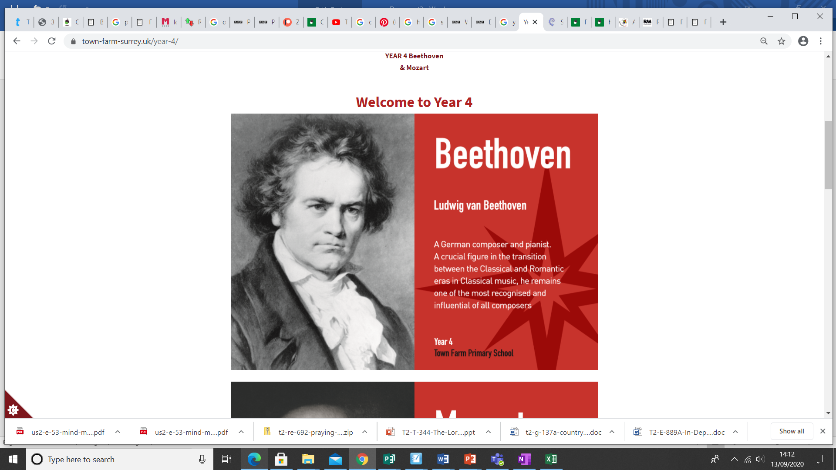


Welcome to Year 4
2025-2026
_________________________________________________________________________
Every Child, Every Day, Every Moment
Our values: Ambition, Courage, Determination, Enquiry, Equality, Integrity, Resilience, Respect

Slide 2
The Team
Beethoven Class: Miss El Azizi and Miss Gosling
Mozart Class: Miss Barnes and Miss Kimber
_________________________________________________________________________
Every Child, Every Day, Every Moment
Our values: Ambition, Courage, Determination, Enquiry, Equality, Integrity, Resilience, Respect

Slide 3




Welcome to Town Farm Primary School & Nursery
Rated OUSTANDING by Ofsted
in all 5 areas 11th March 2025
__________________________________________________________
Every Child, Every Day, Every Moment
Our values: Ambition, Courage, Determination, Enquiry, Equality, Integrity, Resilience, Respect

Slide 4
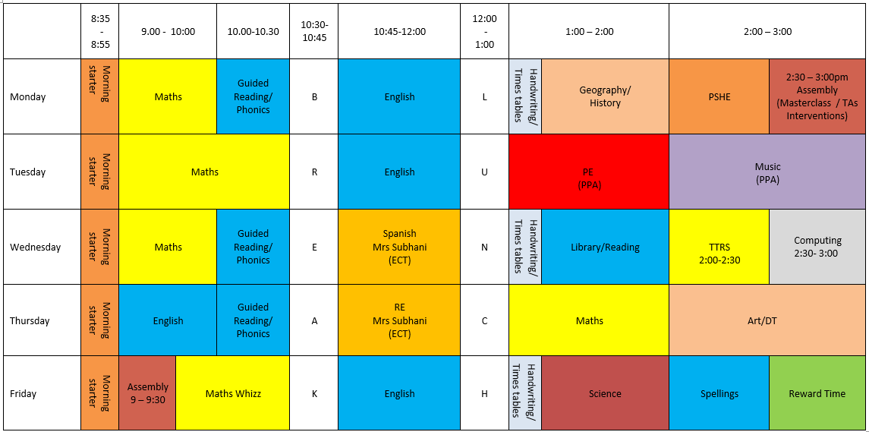
Our Year 4 Beethoven Timetable
_________________________________________________________________________
Every Child, Every Day, Every Moment
Our values: Ambition, Courage, Determination, Enquiry, Equality, Integrity, Resilience, Respect

Slide 5
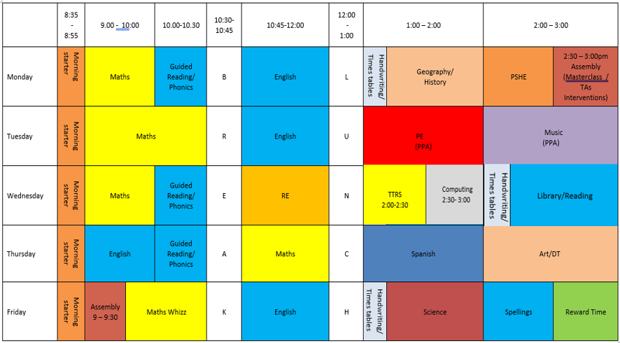
Our Year 4 Mozart Timetable
_________________________________________________________________________
Every Child, Every Day, Every Moment
Our values: Ambition, Courage, Determination, Enquiry, Equality, Integrity, Resilience, Respect

Slide 6
Year 4 Timetable
Wednesday afternoon is our ICT and TTRS slot.
Tuesday afternoon is our P.E. slot, please send the children in full P.E. kit.
Wednesday afternoon is our library slot.
Friday homework and spellings are given out.
Homework is returned the following Wednesday and spellings are completed daily, along with reading.
Swimming will be in the summer term.
_________________________________________________________________________
Every Child, Every Day, Every Moment
Our values: Ambition, Courage, Determination, Enquiry, Equality, Integrity, Resilience, Respect

Slide 7

ENGLISH (Power of Reading)
MATHS
Autumn 1
Gregory Cool
Into the Forest
Autumn 2
Leon and the Place Between
Spring 1
Iron Man
Spring 2
Rhythm of Rain
Cosmic Disco
Summer 1
Arthur and the Golden Rope
Summer 2
Varjak Paw
Autumn 1
Place value
Addition and subtraction
Autumn 2
Addition and subtraction
Area
Multiplication
and division
Spring 1
Multiplication and division
Length and perimeter
Spring 2
Fractions
Decimals
Summer 1
Decimals
Money
Time
Summer 2
Shape
Statistics
Position and direction
Financial awareness
Year 4
2025-26
SCIENCE
Autumn 1
Scientists and Inventors
Autumn 2
Living Things and their Habitats
Spring 1
Electricity
Spring 2
States of Matter
Summer 1
Sound
Summer 2
Animals including Humans
Humanities (Geography and History)
Autumn 1
All Around the World
Autumn 2
Romans
Spring 1
Vikings And Anglo Saxons
Spring 2
Water
Summer 1
Crime and Punishment
Summer 2
What’s it like in Whitby?
Design Technology and Art
Spring 1
Battery Operated Lights
Spring 2
The Great British Bread-Off
Summer 1
British Arts and Artists
Summer 2
Young Entrepreneurs (Juggling Balls)
RE
Autumn 1
Insects
Autumn 2
Rainforests
(Delight)
SPANISH
Autumn 1
What did God promise to his people?
Autumn 2
What did Jesus say about God’s kingdom and why is it ‘good news’?
Spring 1
For Christians,
is communion a celebration or
an act of remembrance?
Spring 2
What do
Sikhs value?
Summer 1
How do non-religious people celebrate
new life?
Summer 2
How do people try to make the world a fairer place?
Autumn 1
Welcome
to School
Autumn 2
My local area,
Your local area
Spring 1
Family Tree
and Faces
Spring 2
Celebrating Carnival/Body Parts
Summer 1
Feeling Unwell/
Jungle Animals
Summer 2
The Weather/
Ice Cream
Computing
MUSIC
Autumn 1
Online Safety
Autumn 2
Animation
Spring 1
Word Processing
Spring 2
Turtle Logo
Summer 1
Scratch
Summer 1
Using and Applying
Autumn 1
Music of Asia
Autumn 2
Christmas carols
Spring 1
The Brass Band
Spring 2
Peter and The Wolf
Summer 1
British Folk Songs
Summer 2
Brilliant Beatles
PSHE
Autumn 1
Being me
Autumn 2
Celebrating Difference (BHM)
Spring 1
Dreams and Goals
Spring 2
Healthy Me
Summer 1
Relationships
Summer 2
Changing Me
SCHOOL TRIPS & VISITORS
Autumn 1
OAA
Autumn 2
Basketball
PE
Spring 1
Golf
Spring
Football
Summer 1
Hockey
Summer 2
Tennis

Slide 8
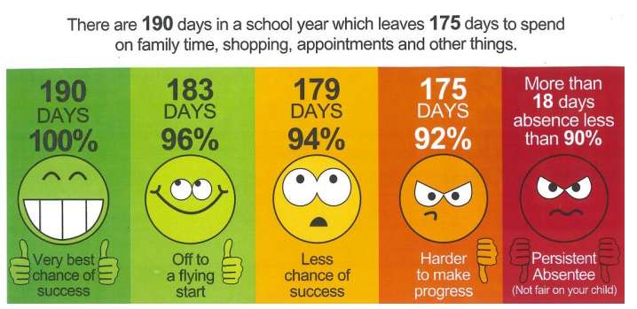
Expectations
Attendance: During term times, your child should attend school regularly. Regular attendance now means 100% of the time the school is open, the minimum target is 96% attendance.
If your child is absent from school, please notify the school on the first day of absence by telephone or email.
_________________________________________________________________________
Every Child, Every Day, Every Moment
Our values: Ambition, Courage, Determination, Enquiry, Equality, Integrity, Resilience, Respect

Slide 9
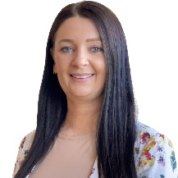

Meet the Attendance Team
Miss Elliott Senior Attendance Champion | Mrs Chilton Attendance Officer
__________________________________________________________
Every Child, Every Day, Every Moment
Our values: Ambition, Courage, Determination, Enquiry, Equality, Integrity, Resilience, Respect

Slide 10
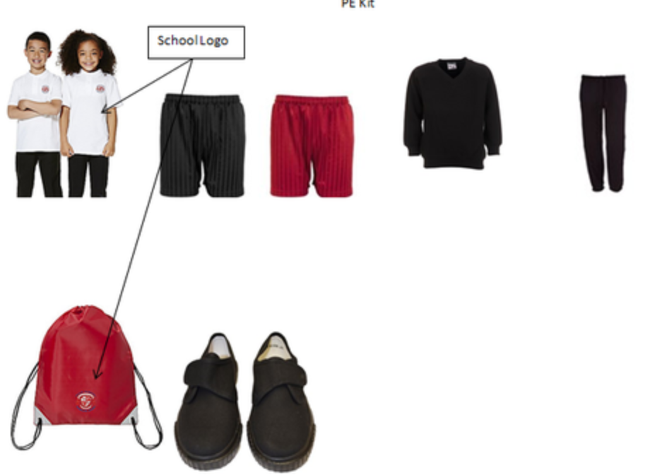
Expectations
Uniform: As per school policy: https://www.town-farm-surrey.uk/school-uniform/
PE kit: Worn on Tuesday: School white polo shirt
Black shorts,
White, grey or black socks
Plain black jogging bottoms and plain black sweatshirt for the winter – no logos or stripes please.
_________________________________________________________________________
Every Child, Every Day, Every Moment
Our values: Ambition, Courage, Determination, Enquiry, Equality, Integrity, Resilience, Respect

Slide 11
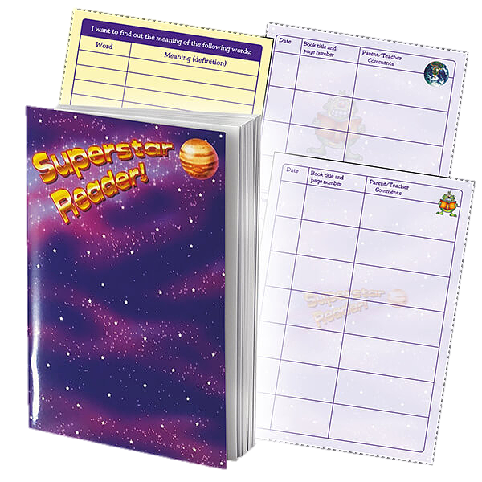

Homework
Daily Reading
To be completed every day and their reading diary signed by an adult. This is checked daily by the teaching assistant. Spellings are to be written out every day and the children are tested on Friday.
When is homework given & due in?
On Friday homework is set for Maths or English.
Completed homework to be handed in on the following Wednesday. Spelling test on Friday morning.
Each half-term there will be a project homework that relates to the next topic.
We love Times Tables Rock Stars too and reward pupils in school who play at home.(Login details for each pupil are in their reading diaries).
_________________________________________________________________________
Every Child, Every Day, Every Moment
Our values: Ambition, Courage, Determination, Enquiry, Equality, Integrity, Resilience, Respect

Slide 12





Our Curriculum
English – Power of Reading
Maths – White Rose
Foundations subjects – Plan it
RE – Surrey PSHE – Jigsaw
Music – Miss London PE – Promise Coaching
Spanish – Primary Languages Network
_________________________________________________________________________
Every Child, Every Day, Every Moment
Our values: Ambition, Courage, Determination, Enquiry, Equality, Integrity, Resilience, Respect

Slide 13
MTC Check
The multiplication tables check (MTC) is statutory for Year 4 pupils in primary schools.
The purpose of the MTC is to determine whether pupils can recall their times tables fluently, which is essential for future success in mathematics.
It will help schools to identify pupils who have not yet mastered their times tables, so that additional support can be provided.
More information can be found at www.gov.uk
_________________________________________________________________________
Every Child, Every Day, Every Moment
Our values: Ambition, Courage, Determination, Enquiry, Equality, Integrity, Resilience, Respect

Slide 14

Rewarding Reading
_________________________________________________________________________
Every Child, Every Day, Every Moment
Our values: Ambition, Courage, Determination, Enquiry, Equality, Integrity, Resilience, Respect

Slide 15

If a child is unhappy we encourage them to speak out about it by:
Talking to a friend
Raising an issue in circle time
Talking to a member of staff
Talking to a learning mentor
Talking to class teacher
Putting a note in the worry eater (this will be seen by a learning mentor)
Speaking to a middle or senior leader
Mental Health and wellbeing
If a child is unhappy we encourage them to speak out about it by:
Talking to a member of staff
Talking to a friend
Raising an issue in circle time
Using their daily check-in
Town Farm wellbeing page: Mental Health and Wellbeing | Town Farm Primary School (town-farm-surrey.uk)
Did you know our pupils have a daily check-in for their well-being?
_________________________________________________________________________
Every Child, Every Day, Every Moment
Our values: Ambition, Courage, Determination, Enquiry, Equality, Integrity, Resilience, Respect

Slide 16

Safeguarding
Your child’s safety is our priority, and we have a shared responsibility to safeguard everyone in our school.
https://www.town-farm-surrey.uk/safeguarding/
SPA: 0300 200 1006
Emergency Duty team: 01483 517898
Surrey Police: 101 (or 999 in an emergency)
www.surreycc.gov.uk/safeguarding
_________________________________________________________________________
Every Child, Every Day, Every Moment
Our values: Ambition, Courage, Determination, Enquiry, Equality, Integrity, Resilience, Respect

Slide 17
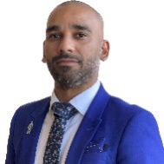
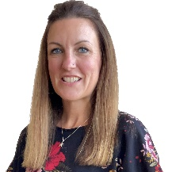
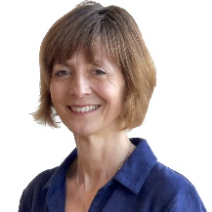
Meet the Senior Leadership Team
Mr Bhatti Headteacher
Miss Elliott Deputy Head Teacher | Mrs Shrimpton Deputy Head Teacher | Mrs Winch Assistant Head Teacher
__________________________________________________________
Every Child, Every Day, Every Moment
Our values: Ambition, Courage, Determination, Enquiry, Equality, Integrity, Resilience, Respect

Slide 18

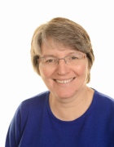
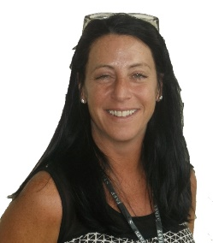
Meet the SENCO and Office Team
Mrs Banthorpe | Mrs Hadley | Mrs Chilton
__________________________________________________________
Every Child, Every Day, Every Moment
Our values: Ambition, Courage, Determination, Enquiry, Equality, Integrity, Resilience, Respect

Slide 19

Additional information
School Website - http://www.town-farm.surrey.sch.uk/
If you have any questions please speak to a member of the Year 4 team who will be happy to help you.
_________________________________________________________________________
Every Child, Every Day, Every Moment
Our values: Ambition, Courage, Determination, Enquiry, Equality, Integrity, Resilience, Respect

