Slide 1


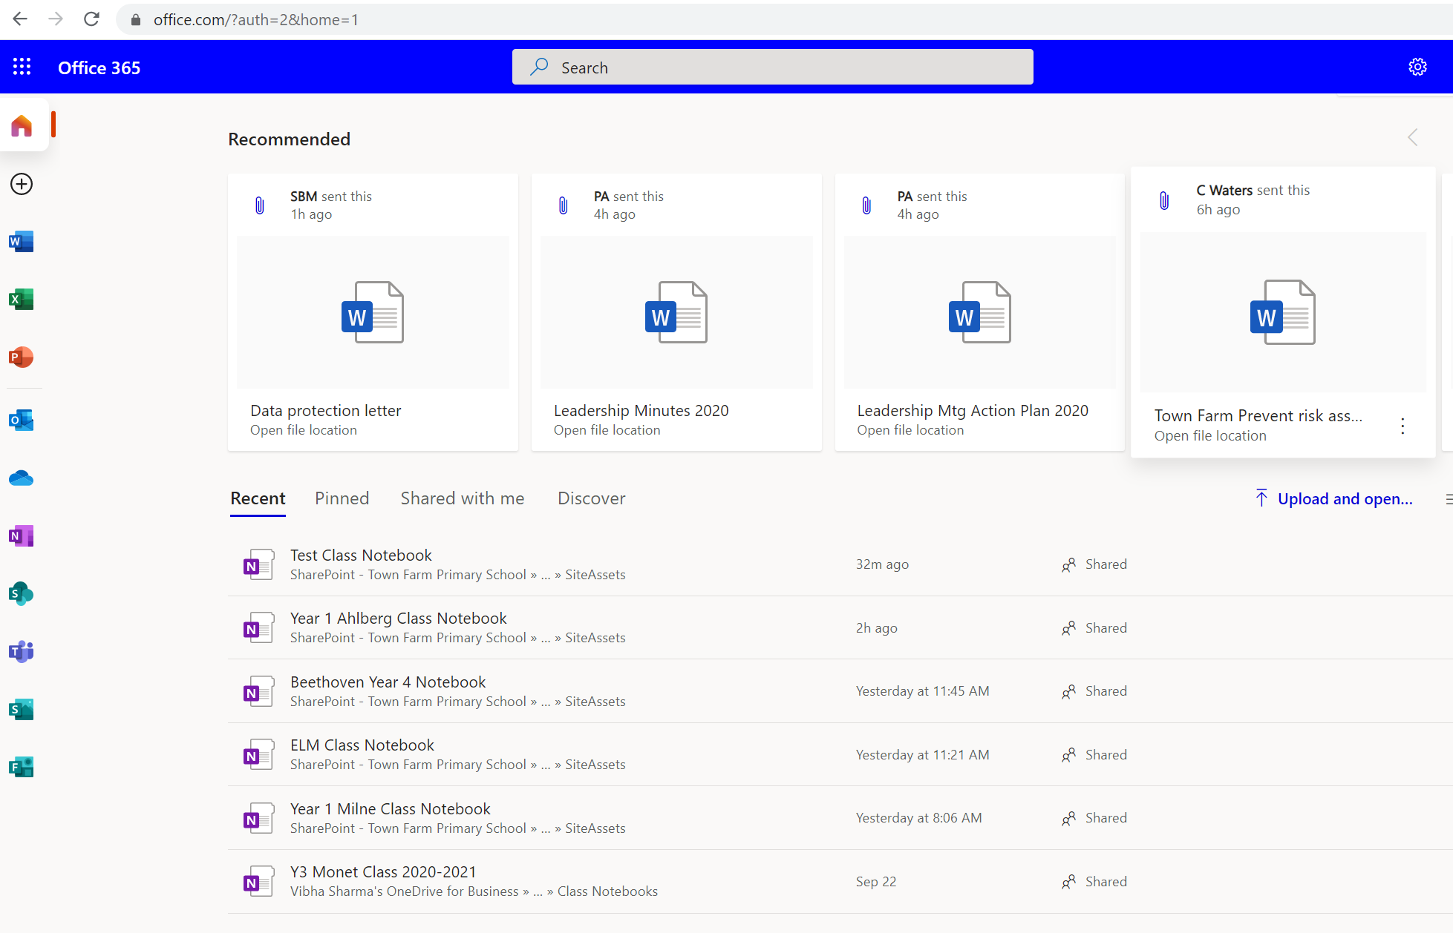
Town Farm Primary School
Guide to Remote Learning
1. Go to http://portal.office.com and sign in with your child’s school email and password.
2. Open OneNote:
Click on the icon in the sidebar or select a recent class.

Slide 2
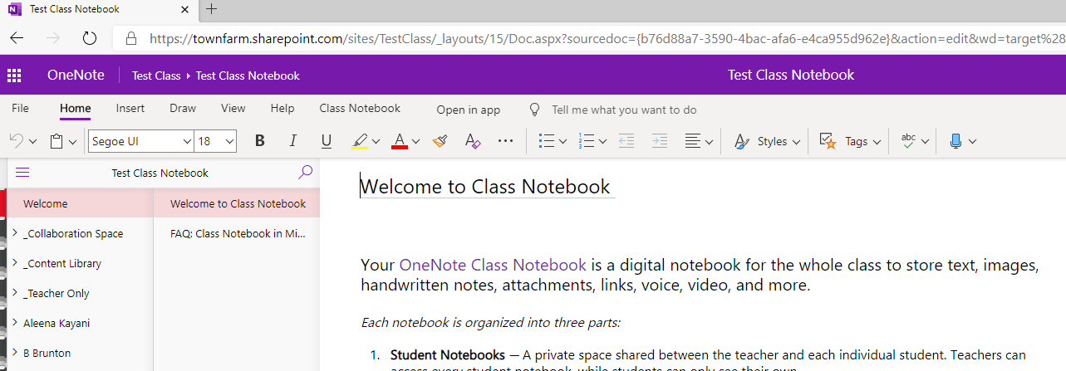
3. You will be able to see folders along the sidebar, including one for your child.
Child’s Name

Slide 3
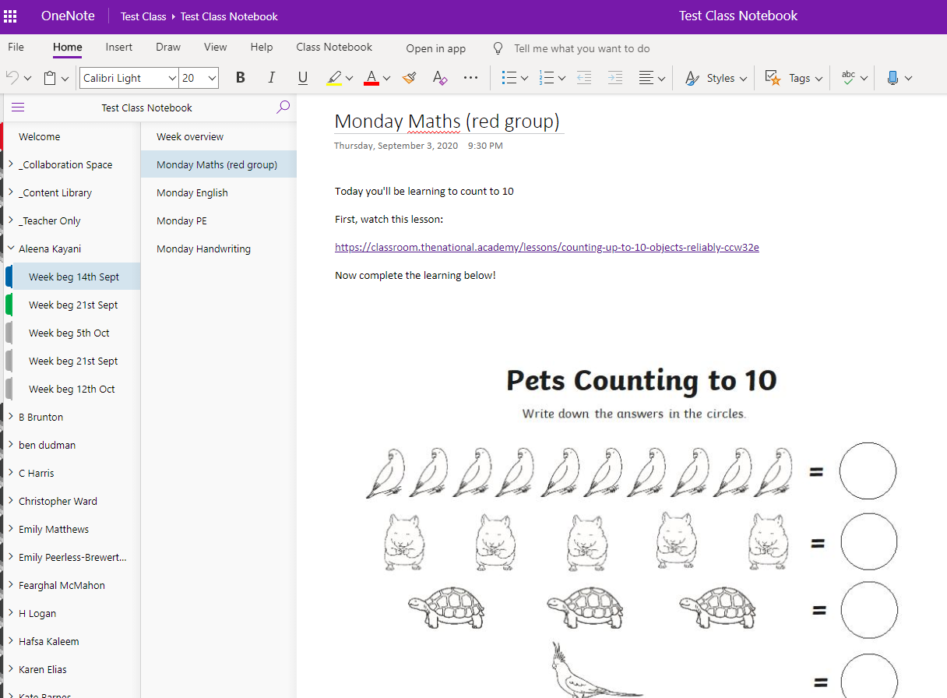
4. Click on your child’s name and you will find folders organised for learning.
Your child
5. Click on the page to find the work.

Slide 4
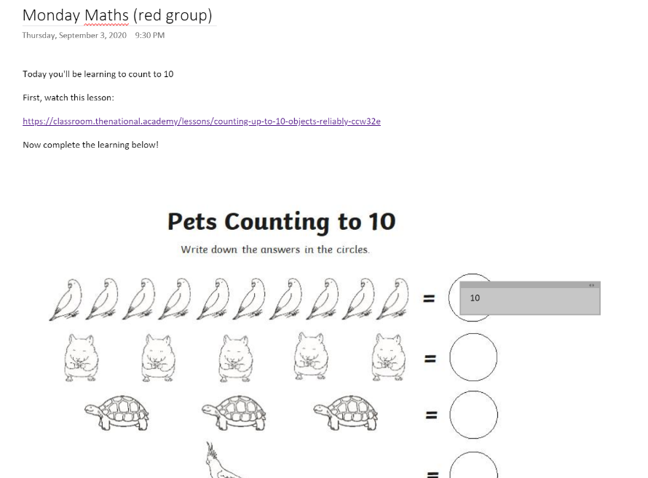
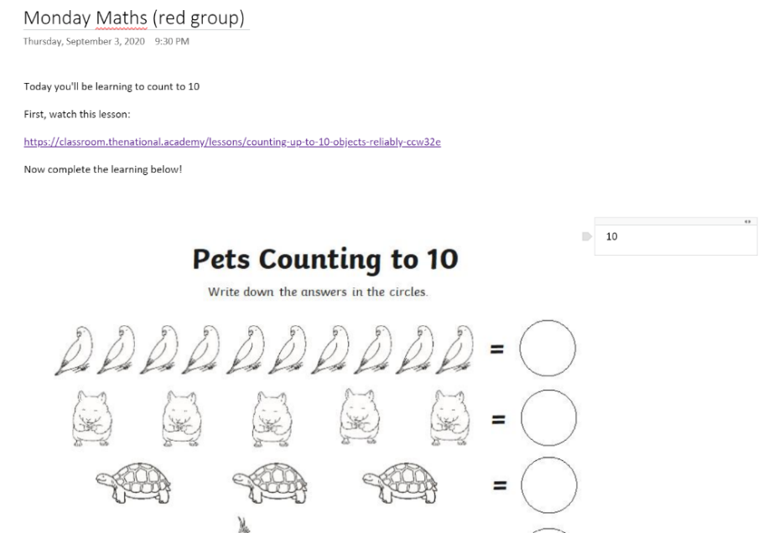
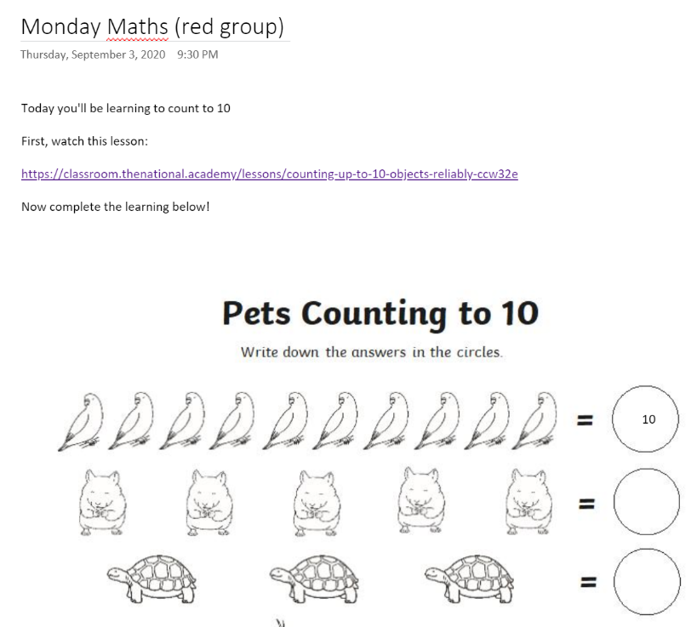
6. Click anywhere in an open space to start typing the answer.
7. You can move the text into the right place.

Slide 5
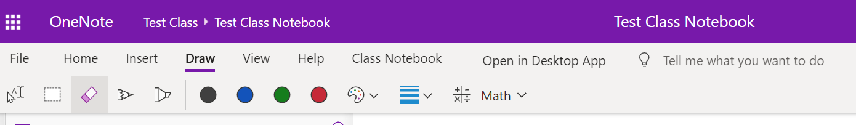
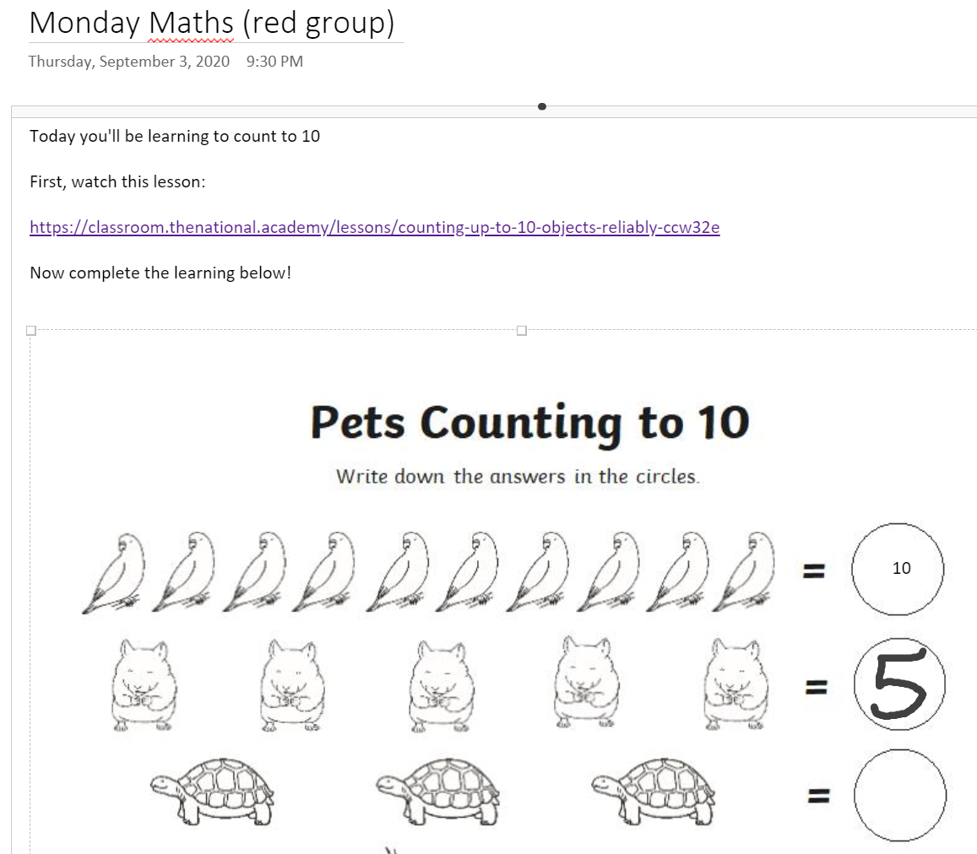
8. If you have a tablet / touch screen / pen-enabled device, you can use the draw tool to write the answer.

Slide 6
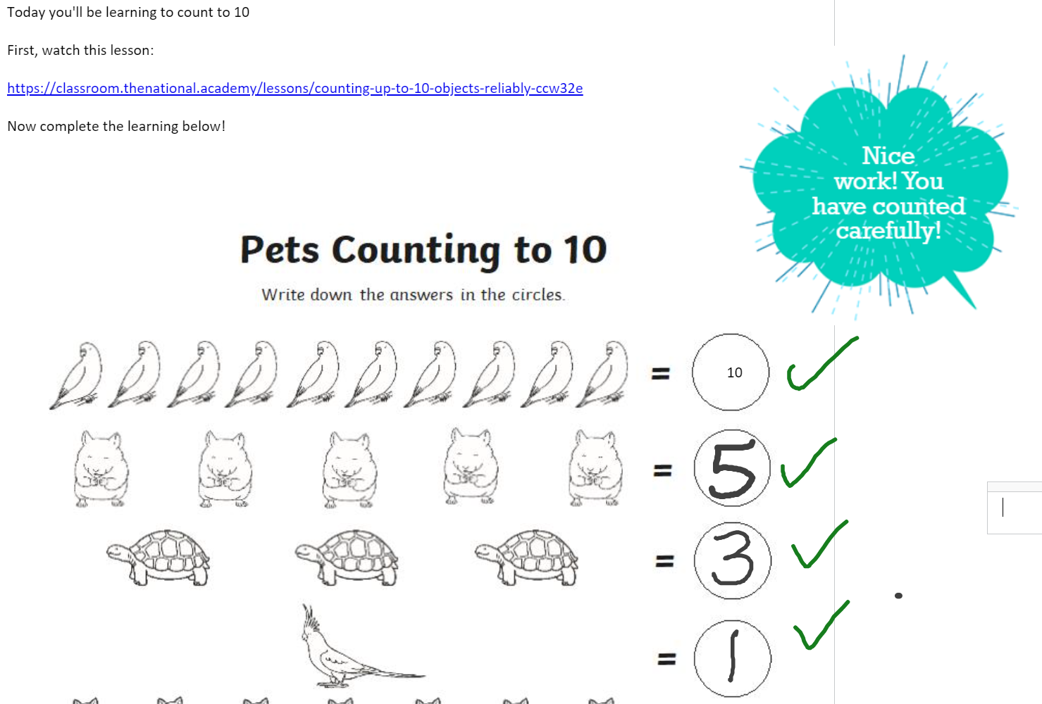
9. Simply close the app when you are finished.
Your child’s teacher will be able to see their work and provide feedback.

Slide 7
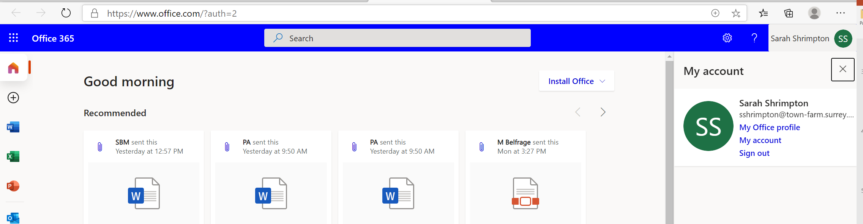
10. Remember to sign out of your account if you share the device. Return to the office portal and click on your name.
Child’s Name
Child’s Name
11. Click ‘Sign out’

Slide 8
1. Go to http://portal.office.com and sign in with your child’s school email and password.
2. Open OneNote: Click on the icon in the sidebar or select a recent class.
3. You will be able to see folders along the sidebar, including one for your child.
4. Click on your child’s name and you will find folders organised for learning.
5. Click on the page to find the work.
6. Click anywhere in an open space to start typing the answer.
7. You can move the text into the right place.
8. If you have a tablet / touch screen / pen-enabled device, you can use the draw tool to write the answer.
9. Simply close the app when you are finished. Your child’s teacher will be able to see their work and provide feedback.
10. Remember to sign out of your account if you share the device. Return to the office portal and click on your name then select ‘Sign out’.

