Slide 1
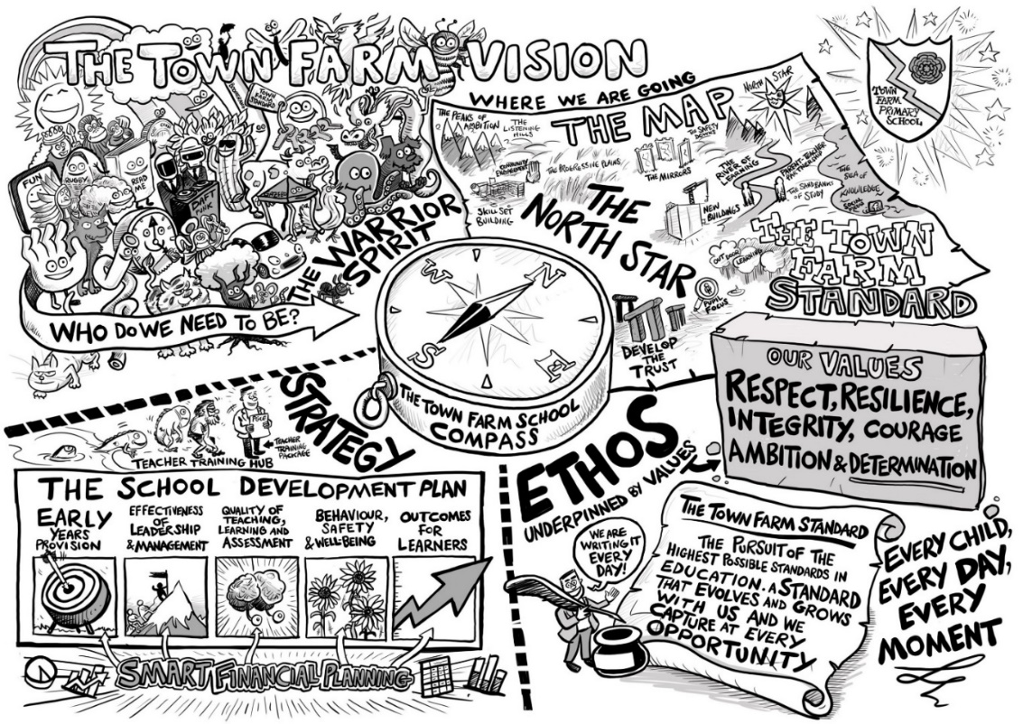


Meet the Pastoral Team
Parent Workshop
16th March 2023
_________________________________________________________________________
Every Child, Every Day, Every Moment
Our values: Ambition, Courage, Determination, Enquiry, Equality, Integrity, Resilience, Respect

Slide 2


Aims of Today:
To recognise the Pastoral Team at Town Farm and to understand their roles with the pupils.
To understand the protocols when requesting support for a pupil.
To know the interventions run at Town Farm to support the whole child.
_________________________________________________________________________
Every Child, Every Day, Every Moment
Our values: Ambition, Courage, Determination, Enquiry, Equality, Integrity, Resilience, Respect

Slide 3
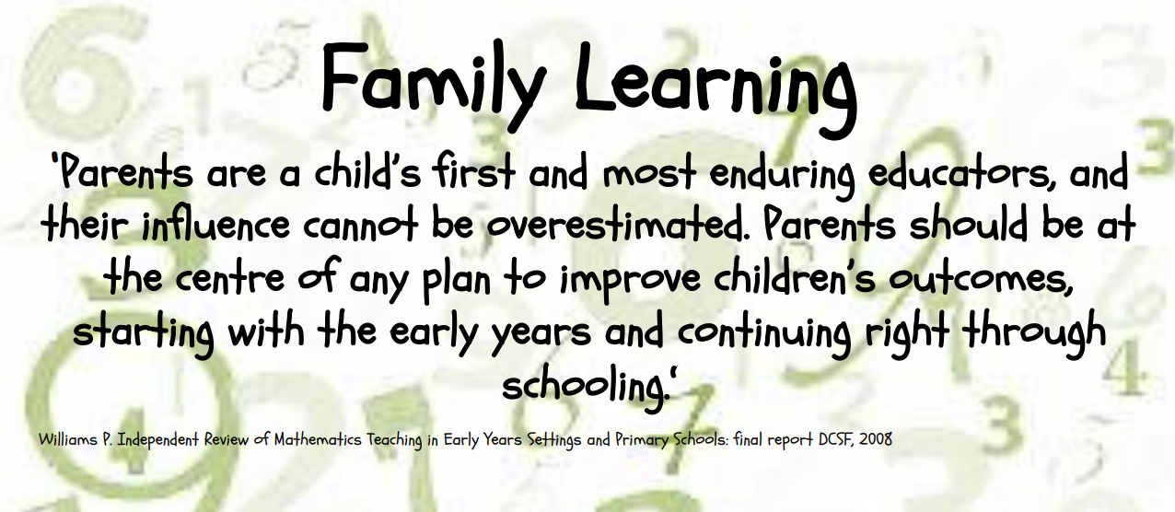
_________________________________________________________________________
Every Child, Every Day, Every Moment
Our values: Ambition, Courage, Determination, Enquiry, Equality, Integrity, Resilience, Respect

Slide 4


I am the Special Needs Coordinator with the National Senco Award qualification.
I am an experienced teacher who is responsible for supporting, assessing and monitoring the progress of pupils with SEND (Special Educational Needs and/or Disabilities).
I am the person who liaises with you, the teachers and local authority about your child's needs.
I rely on your help and support too: if you are aware that your child has any kind of difficulty, inform the staff at the earliest opportunity and share all relevant documentation. This will give staff time to put plans in place to ensure a smooth integration into the new school environment.
Meet the Team…SENCO
Claire Smith
_________________________________________________________________________
Every Child, Every Day, Every Moment
Our values: Ambition, Courage, Determination, Enquiry, Equality, Integrity, Resilience, Respect

Slide 5
Meet the Team…Deputy Headteacher, Lead DSL, Behaviour and Attitudes lead
Cathy Waters
I am the designated safeguarding lead and deputy head teacher with responsibilities for behaviour and attitudes
I oversee safeguarding and child protection in the school, including online safety, and liaise with external agencies to ensure the correct support is put in place when there is concern. These agencies may include Surrey Children’s Services, Health and the Police
I also manage behaviour and attitudes within the school, ensuring there are high expectations for learners’ behaviour and conduct and that these expectations are applied consistently and fairly, bearing in mind individual pupils’ needs
_________________________________________________________________________
Every Child, Every Day, Every Moment
Our values: Ambition, Courage, Determination, Enquiry, Equality, Integrity, Resilience, Respect

Slide 6
Meet the Team…Deputy Headteacher, Lead DSL, Behaviour and Attitudes lead
Cathy Waters
I am here to listen to pupils’ concerns, including any concern of bullying or child-on-child abuse and through restorative practice help pupils resolve differences quickly and effectively and build positive and respectful relationships
I also have responsibility for attendance and punctuality and monitor this closely alongside the welfare officer and the Surrey Inclusion Service
I also work closely with the SENCO where there are concerns for pupil behaviour and mental health
_________________________________________________________________________
Every Child, Every Day, Every Moment
Our values: Ambition, Courage, Determination, Enquiry, Equality, Integrity, Resilience, Respect

Slide 7
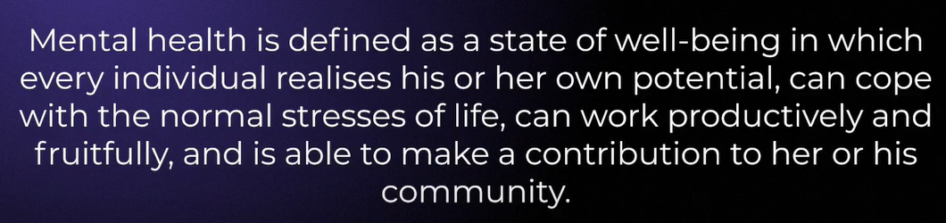
Meet the Team…Mental Health Lead
Louise Ravenor
_________________________________________________________________________
Every Child, Every Day, Every Moment
Our values: Ambition, Courage, Determination, Enquiry, Equality, Integrity, Resilience, Respect

Slide 8
Meet the Team…Mental Health Lead
Louise Ravenor
Developing and leading the whole school strategy to support pupil and staff mental health
Prioritising building resilience in our pupils
Training to ensure knowledge and expertise in supporting pupils and their families.
PSHE – Jigsaw curriculum alignment
Positive working environment and pupil outcomes
Zones of Regulation
_________________________________________________________________________
Every Child, Every Day, Every Moment
Our values: Ambition, Courage, Determination, Enquiry, Equality, Integrity, Resilience, Respect

Slide 9
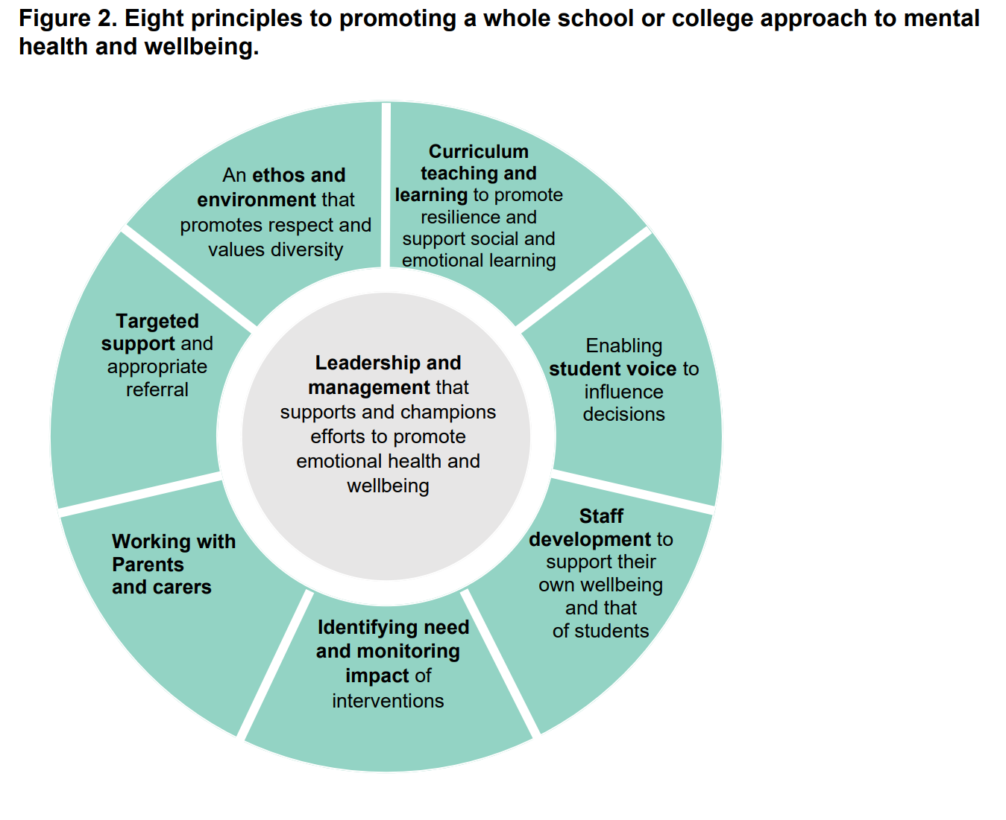
Meet the Team…Mental Health Lead
Louise Ravenor
Working together as pastoral team is essential to ensure we promote and support positive emotional health and wellbeing across the whole community.
_________________________________________________________________________
Every Child, Every Day, Every Moment
Our values: Ambition, Courage, Determination, Enquiry, Equality, Integrity, Resilience, Respect

Slide 10
Meet the Team…Learning Mentors,
Tina Goddard, Roxanne Catchpole and Sadaf Memon
Mrs Catchpole. I support pupils with behaviour, managing emotions, anger management, Ready2Learn skills and improving attitude towards learning. I am trained as an Emotional Literacy Support Assistant (ELSA) and I am a mental health first aider.
Mrs Goddard. I support pupils with behaviour, anger management, Ready2Learn skills, managing emotions, achieving targets and SEMH. I am also ELSA trained.
Mrs Memon. I am here to facilitate pupils’ learning so they can thrive, by increasing motivation and building confidence as well as resilience. I can help pupils improve their concentration and most importantly their ready to learn skills. I am also ELSA trained.
_________________________________________________________________________
Every Child, Every Day, Every Moment
Our values: Ambition, Courage, Determination, Enquiry, Equality, Integrity, Resilience, Respect

Slide 11
We develop one-to-one mentoring relationships with pupils.
We support pupils while they take part in lessons and activities. We inspire, motivate and promote positive behaviour and relationships.
We offer a sympathetic ear to young people with a range of behavioural, emotional and learning difficulties.
We relate to young people with a wide range of abilities and often from diverse social backgrounds.
We jointly develop plans of action to help young people overcome barriers to achieving their full potential
We liaise with parents and carers
We work closely with other professionals, alongside the SENCO.
Meet the Team…Learning Mentors,
Tina Goddard, Roxanne Catchpole and Sadaf Memon
_________________________________________________________________________
Every Child, Every Day, Every Moment
Our values: Ambition, Courage, Determination, Enquiry, Equality, Integrity, Resilience, Respect

Slide 12
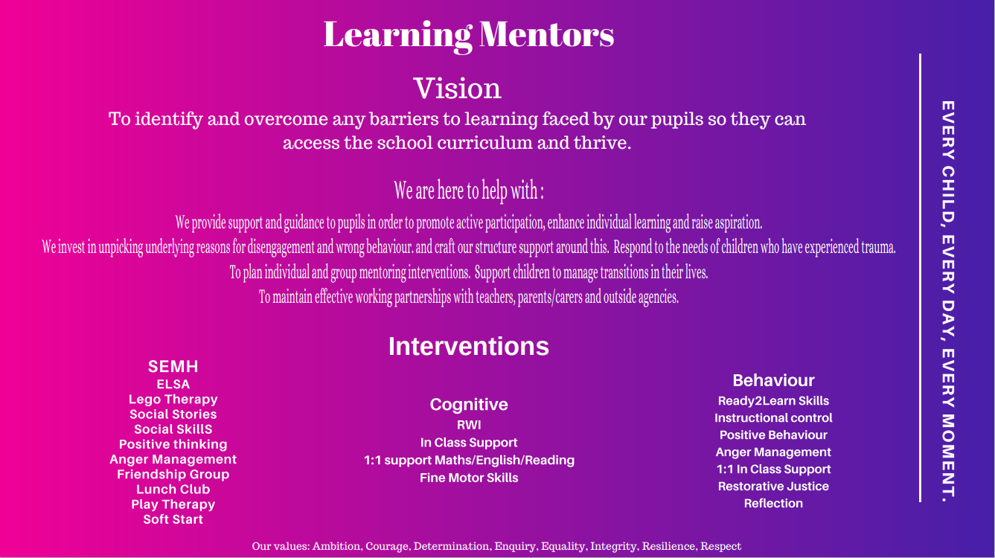
Meet the Team…Learning Mentors,
_________________________________________________________________________
Every Child, Every Day, Every Moment
Our values: Ambition, Courage, Determination, Enquiry, Equality, Integrity, Resilience, Respect

Slide 13
To create an environment that meets the special educational needs of each child, both physically and academically;
To ensure that the special educational needs of pupils are identified as early as possible, assessed and provided for;
To enable all pupils to have full access to the school curriculum;
To have high expectations and set suitable targets for all pupils;
To ensure parents are part of all processes to support their children to progress and access education;
To ensure our pupils have a voice in all processes, where appropriate;
That all pupils are entitled to access the full school curriculum and to take part in every aspect of school life, unless there is a specified modification or disapplication outlined in an individual pupil’s Statement of Special Educational Need or EHCP (Education, Health and Care Plan).
Meet the Team…What do we do
_________________________________________________________________________
Every Child, Every Day, Every Moment
Our values: Ambition, Courage, Determination, Enquiry, Equality, Integrity, Resilience, Respect

Slide 14
Meet the Team…What do we do
Children will find it difficult to access learning opportunities if they are experiencing barriers to learning. These barriers can include:
Anxiety and worries,
Difficulties at home,
Behaviour for learning challenges,
Issues concerning bullying/friendships/social anxieties,
Dealing with bereavement/loss,
General disaffection and disengagement from learning,
Worries about transferring from primary to secondary school,
Difficulties with organisation,
Anger Management
SEMH- Social skills, Self-esteem, Honesty, Positive thinking,
SEND needs,
Mental Health.
_________________________________________________________________________
Every Child, Every Day, Every Moment
Our values: Ambition, Courage, Determination, Enquiry, Equality, Integrity, Resilience, Respect

Slide 15
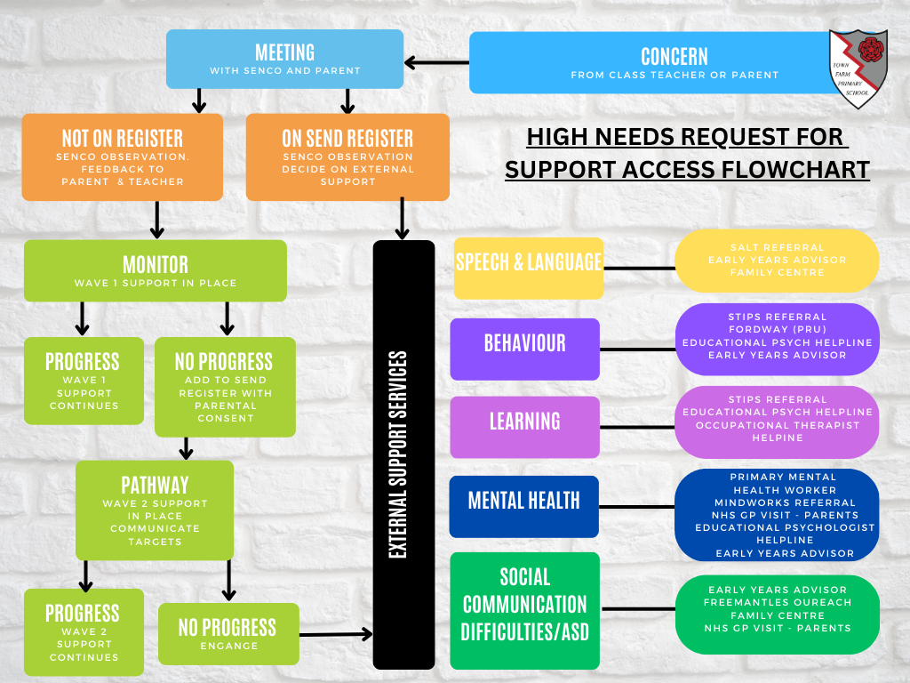
Meet the Team… protocols when requesting support for a pupil.
_________________________________________________________________________
Every Child, Every Day, Every Moment
Our values: Ambition, Courage, Determination, Enquiry, Equality, Integrity, Resilience, Respect

Slide 16
Meet the Team…Interventions run at Town Farm.
Intervention | Year Group
EAL KS1 and KS2 | Years 3, 4, 5, 6, R
On Track Writing | Years 2, 3, 5
Bubble Handwriting (Trial) | Years 3, 5
Extra reading (Kim A) | Years 3, 4
Rapid Reading | Years 3, 4, 5
1:1 Phonics | Years Rec, 1, 2, 3, 4, 5
Shine | Years 3, 4, 5, 6
3rd Space Learning | Years 5
Handies (Fine motor skills) | Years 1, 4, 5
1:1 reading | Years 6
Colourful semantics (speech pupils) | Years Rec, Y2
Language for Thinking (speech pupils) | Years 3, 4, 5
Number | Years Rec, 1
Fresh Start | Years 6
Social skills (Learning Mentors) | Years KS1 and KS2
ELSA (Learning Mentors) | Years KS1 and KS2
Toe by Toe | Year 5
Pre-teaching | Years KS1 and KS2
Stile Phonics | Years 3, 4, 5 (lowest 20%)
Precision Teaching | Years 3, 4, 5 (lowest 20% and EAL)
_________________________________________________________________________
Every Child, Every Day, Every Moment
Our values: Ambition, Courage, Determination, Enquiry, Equality, Integrity, Resilience, Respect

Slide 17
If a child is unhappy we encourage them to speak out about it by:
Talking to a friend
Raising an issue in circle time
Talking to a member of staff
Talking to a learning mentor
Talking to class teacher
Putting a note in the worry eater (this will be seen by a learning mentor)
Speaking to a middle or senior leader
Any Questions?
_________________________________________________________________________
Every Child, Every Day, Every Moment
Our values: Ambition, Courage, Determination, Enquiry, Equality, Integrity, Resilience, Respect

