Slide 1




Welcome to Town Farm Primary School & Nursery
Rated OUTSTANDING by Ofsted
in all 5 areas 11th March 2025
__________________________________________________________
Excellence, Endeavour, Equanimity
Our values: Ambition, Courage, Determination, Enquiry, Equality, Integrity, Resilience, Respect

Slide 2

Welcome to Town Farm Primary School & Nursery
__________________________________________________________
Excellence, Endeavour, Equanimity
Our values: Ambition, Courage, Determination, Enquiry, Equality, Integrity, Resilience, Respect

Slide 3
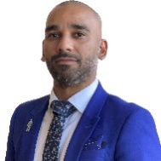

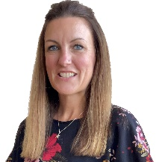

Meet the Senior Leadership Team
Mr Bhatti Headteacher
Miss Elliott Deputy Head Teacher | Mrs Shrimpton Deputy Head Teacher | Mrs Winch Assistant Head Teacher
__________________________________________________________
Excellence, Endeavour, Equanimity
Our values: Ambition, Courage, Determination, Enquiry, Equality, Integrity, Resilience, Respect

Slide 4



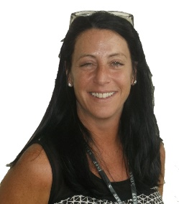
Meet the SENCO and Office Team
Mrs Banthorpe | Mrs Hadley | Mrs Chilton
__________________________________________________________
Excellence, Endeavour, Equanimity
Our values: Ambition, Courage, Determination, Enquiry, Equality, Integrity, Resilience, Respect

Slide 5
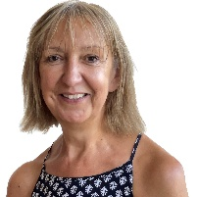
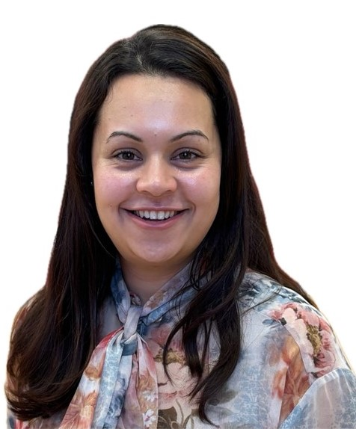
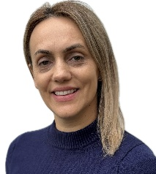
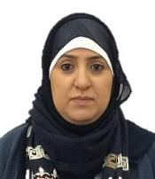
Meet the Nursery Team
Mrs Barnes EYFS Lead | Miss Paice Nursery Teacher
Mrs Camara EYFS Teaching Assistant | Mrs Yassa Nursery Nurse
__________________________________________________________
Excellence, Endeavour, Equanimity
Our values: Ambition, Courage, Determination, Enquiry, Equality, Integrity, Resilience, Respect

Slide 6


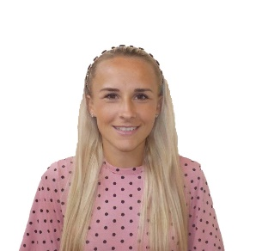
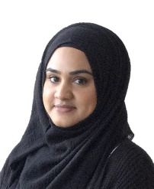
Meet the Reception Team
Mrs Barnes EYFS Lead and Rosen Class Teacher | Mrs Bennett Donaldson Class Teacher
Mrs Lawrence Nursery Nurse | Mrs Kabir EYFS Teaching Assistant
__________________________________________________________
Excellence, Endeavour, Equanimity
Our values: Ambition, Courage, Determination, Enquiry, Equality, Integrity, Resilience, Respect

Slide 7
Attendance and Illness
Please phone the school and inform the office if your child is unable to attend and state the reason why. This must be done every day your child is not attending.
Please note that following sickness/ diarrhoea your child needs to have been clear of symptoms for 48 hours before returning to school
Meet the Attendance Team
Miss Elliott Senior Attendance Champion | Mrs Chilton Attendance Officer
__________________________________________________________
Excellence, Endeavour, Equanimity
Our values: Ambition, Courage, Determination, Enquiry, Equality, Integrity, Resilience, Respect

Slide 8
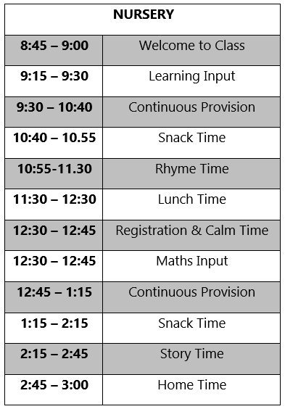
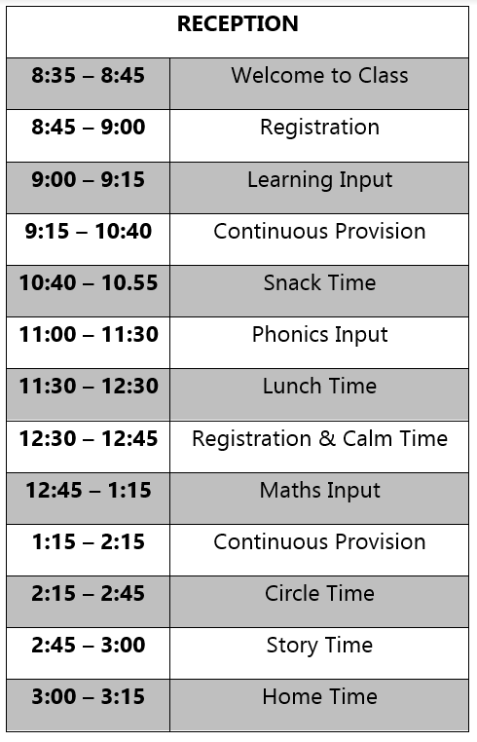
A typical day in EYFS
__________________________________________________________
Excellence, Endeavour, Equanimity
Our values: Ambition, Courage, Determination, Enquiry, Equality, Integrity, Resilience, Respect

Slide 9

What is the EYFS?
__________________________________________________________
Excellence, Endeavour, Equanimity
Our values: Ambition, Courage, Determination, Enquiry, Equality, Integrity, Resilience, Respect

Slide 10
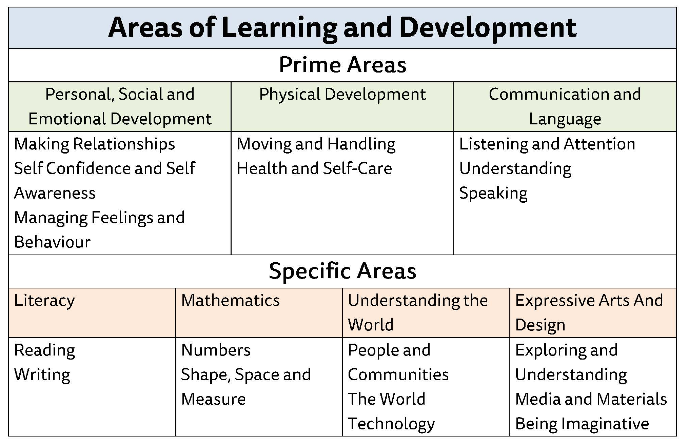
What are the areas of learning in EYFS?
__________________________________________________________
Excellence, Endeavour, Equanimity
Our values: Ambition, Courage, Determination, Enquiry, Equality, Integrity, Resilience, Respect

Slide 11


Lunch choices
School Dinners
Free for Rec, Year 1 & 2
School Dinners in Nursery must be paid for
Or
Packed Lunch
Please visit our lunch providers today
__________________________________________________________
Excellence, Endeavour, Equanimity
Our values: Ambition, Courage, Determination, Enquiry, Equality, Integrity, Resilience, Respect

Slide 12

__________________________________________________________
Excellence, Endeavour, Equanimity
Our values: Ambition, Courage, Determination, Enquiry, Equality, Integrity, Resilience, Respect

Slide 13

Uniform
This is available through https://www.schooluniformdirect.co.uk/schools/183/town-farm-primary-school
Please ensure all uniform is named
__________________________________________________________
Excellence, Endeavour, Equanimity
Our values: Ambition, Courage, Determination, Enquiry, Equality, Integrity, Resilience, Respect

Slide 14

Uniform Requirements
Earrings are not permitted at school. If earrings cannot be removed, they must be taped over prior to attending school.
__________________________________________________________
Excellence, Endeavour, Equanimity
Our values: Ambition, Courage, Determination, Enquiry, Equality, Integrity, Resilience, Respect
Notes:
Only short sleeves
Don’t by the coat
Label
No laces for PE

Slide 15

Uniform Requirements
__________________________________________________________
Excellence, Endeavour, Equanimity
Our values: Ambition, Courage, Determination, Enquiry, Equality, Integrity, Resilience, Respect
Notes:
Only short sleeves
Don’t by the coat
Label
No laces for PE

Slide 16

What happens to uniform in EYFS?
__________________________________________________________
Excellence, Endeavour, Equanimity
Our values: Ambition, Courage, Determination, Enquiry, Equality, Integrity, Resilience, Respect
Notes:
Only short sleeves
Don’t by the coat
Label
No laces for PE

Slide 17



Home School Links
Observations are pictures and comments about your child and their learning. These go onto our online system (Tapestry). You will receive a login to enable you to see the observations we do at school, but you will also be able to upload your own from photos and videos from home.
In Reception we ask parents to complete a daily reading activity with their child and a weekly home learning activity. The home learning tasks will often be practical and talk based and will give you an insight into what your child is learning.
__________________________________________________________
Excellence, Endeavour, Equanimity
Our values: Ambition, Courage, Determination, Enquiry, Equality, Integrity, Resilience, Respect

Slide 18

School Readiness
Please read the guidance for parents about how to help your child get ready for school.
Most important things parents can do:
Help their child be independent particularly with eating, dressing and toileting
Ensuring a good bedtime routine (by 7pm or earlier)
__________________________________________________________
Excellence, Endeavour, Equanimity
Our values: Ambition, Courage, Determination, Enquiry, Equality, Integrity, Resilience, Respect

Slide 19
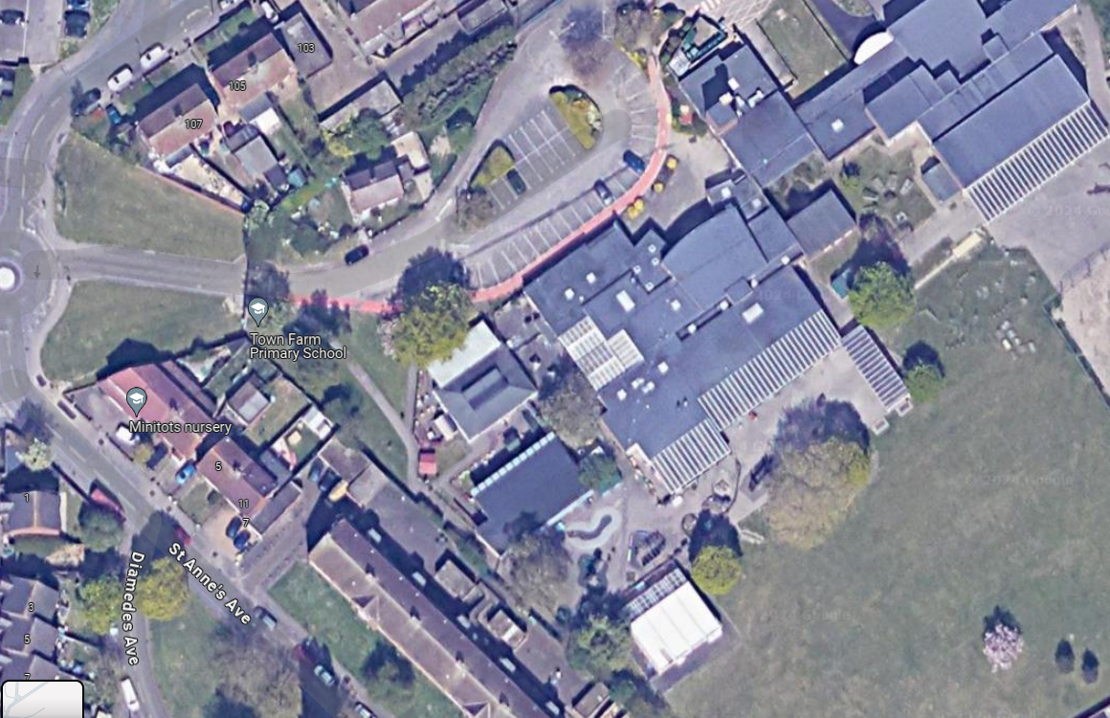


Drop Off and Pick Up
__________________________________________________________
Excellence, Endeavour, Equanimity
Our values: Ambition, Courage, Determination, Enquiry, Equality, Integrity, Resilience, Respect

Slide 20

Dates For Your Diary
Nursery
‘Stay and Play’ Session – Wednesday 1st July
Please sign up for a slot if you haven't already.
Nursery Home Visit Times – have been sent out in your packs
Reception
‘Moving Up Day’ - Monday 6th July 9.30am until 11.15am
Children do not need to wear uniform for this session
__________________________________________________________
Excellence, Endeavour, Equanimity
Our values: Ambition, Courage, Determination, Enquiry, Equality, Integrity, Resilience, Respect

Slide 21

Staggered Starts
You will receive a letter telling you your child’s start date and start time. Once they are in school, they will attend for their full sessions unless this has otherwise been agreed with the school.
Nursery Start Dates
Between Wednesday 2nd September and Tuesday 9th
September
Reception Start Dates
Between Wednesday 2nd September and Friday 4th September
__________________________________________________________
Excellence, Endeavour, Equanimity
Our values: Ambition, Courage, Determination, Enquiry, Equality, Integrity, Resilience, Respect

Slide 22

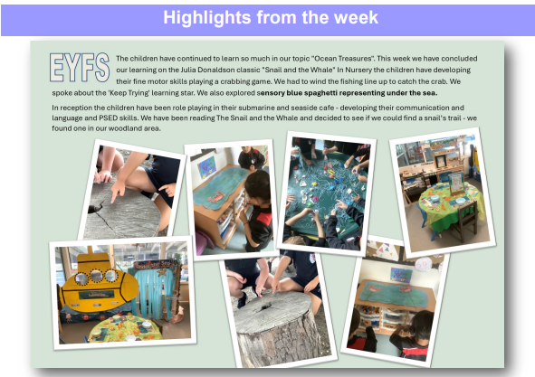
Communication
You will receive a weekly newsletter giving you key dates as well as sharing what the children have been learning in EYFS.
__________________________________________________________
Excellence, Endeavour, Equanimity
Our values: Ambition, Courage, Determination, Enquiry, Equality, Integrity, Resilience, Respect

Slide 23


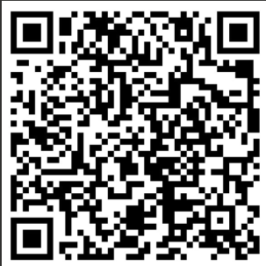

Excellence, Endeavour, Equanimity
Communication
Please follow our Instagram account to receive an insight on life inside our school.
__________________________________________________________
Excellence, Endeavour, Equanimity
Our values: Ambition, Courage, Determination, Enquiry, Equality, Integrity, Resilience, Respect

Slide 24

EYFS Statutory Framework:
Parents as Partners: ‘Parents are children’s first and most enduring educators. When parents and practitioners work together in early years settings, the results have a positive impact on children’s development and learning.’
Please contact our school office for any questions or concerns you may have, who will pass it onto our EYFS Team
info@town-farm.surrey.sch.uk
Telephone: 01784 254380
Please join us for a tour of Early Years, visit our lunchtime providers, our uniform providers and feel free to ask any questions.
__________________________________________________________
Excellence, Endeavour, Equanimity
Our values: Ambition, Courage, Determination, Enquiry, Equality, Integrity, Resilience, Respect

